Slide 1
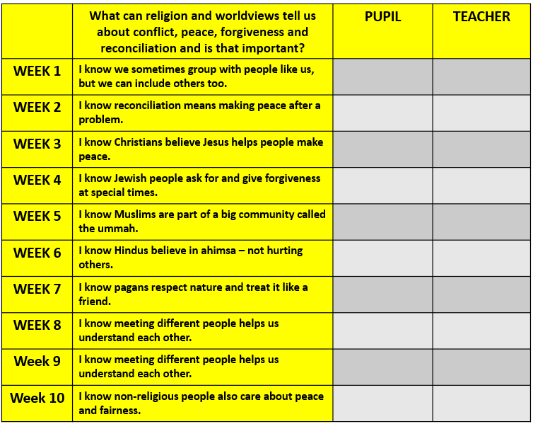





What can religion and worldviews tell us about conflict, peace, forgiveness and reconciliation and is that important?
My answer to our topic question:
_______________________________________________________________________________________________________________________________________________________________________________________________________________________________________

Slide 2

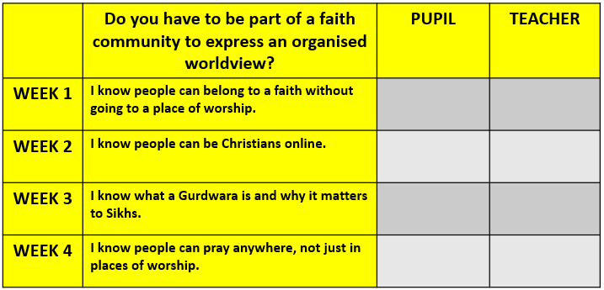


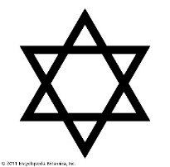
Do you have to be part of a faith community to express an organised worldview?
My answer to our topic question:
__________________________________________________________________________________________________________________________________________________________________________________________________________________________________________

Slide 3
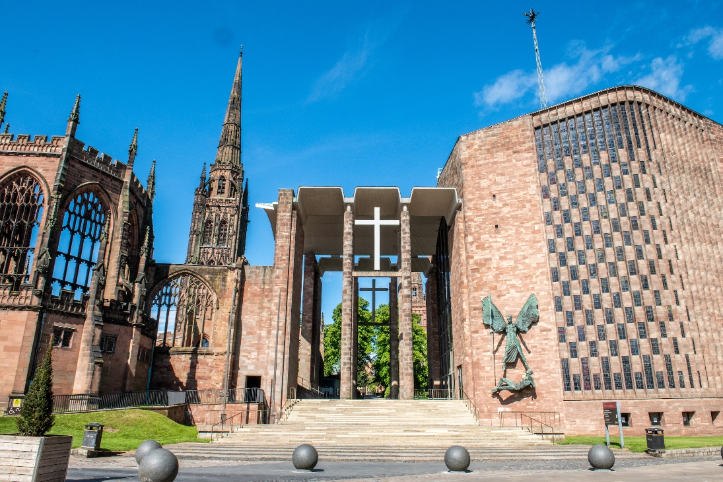
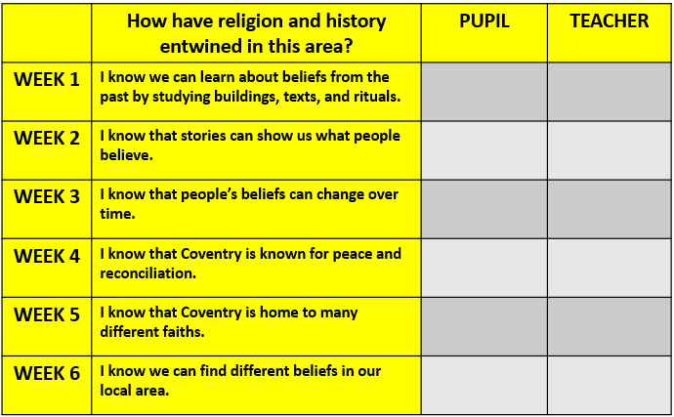
How have religion and history entwined in this area?
My answer to our topic question:
__________________________________________________________________________________________________________________________________________________________________________________________________________________________________________

Slide 4
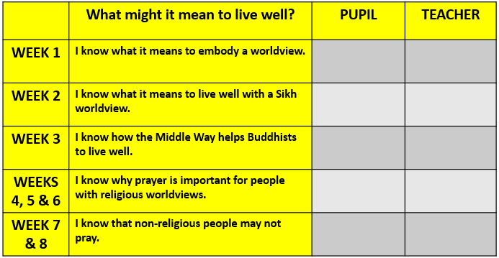


What might it mean to live well?
My answer to our topic question:
____________________________________________________________________________________________________________________________________________________________________________________________________________________________________

Slide 5
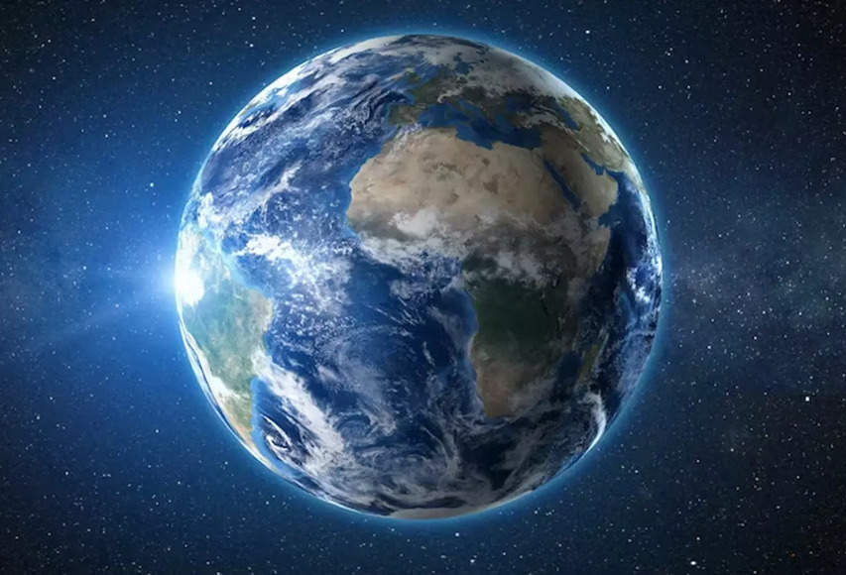
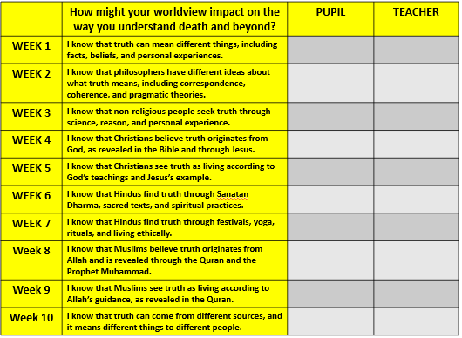
How might your worldview impact on the way you understand death and beyond?
My answer to our topic question:
_______________________________________________________________________________________________________________________________________________________________________________________________________________________________________

