Slide 1
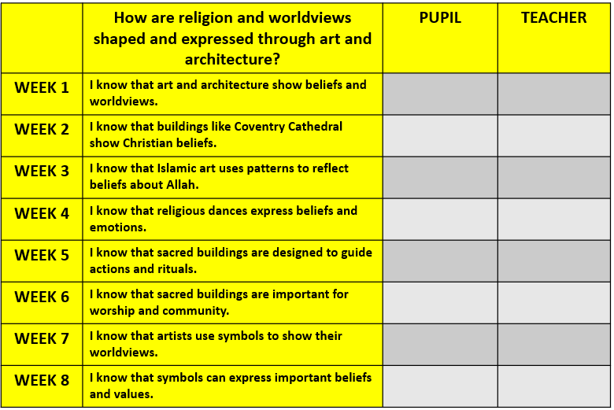
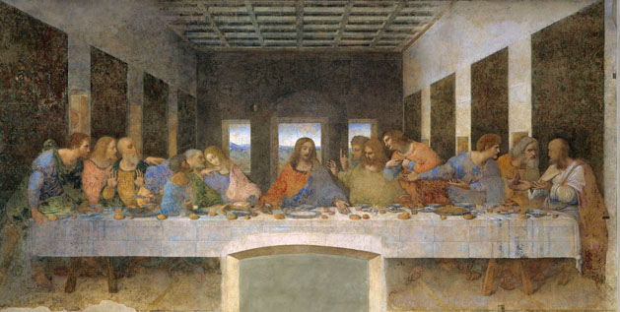




How are religion and worldviews shaped and expressed through art and architecture?
My answer to our topic question:
_______________________________________________________________________________________________________________________________________________________________________________________________________________________________________

Slide 2

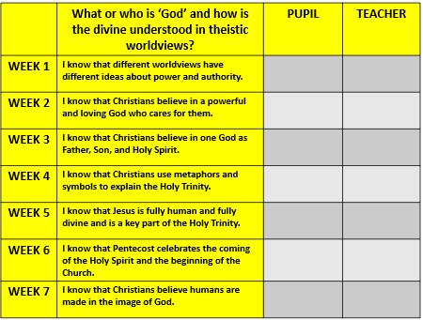




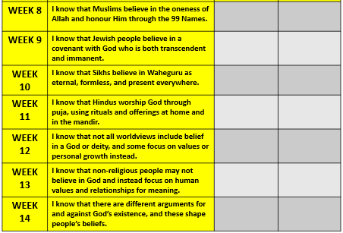
What or who is ‘God’ and how is the divine understood in theistic worldviews?
My answer to our topic question:
_____________________________________________________________________________________________________________________

Slide 3

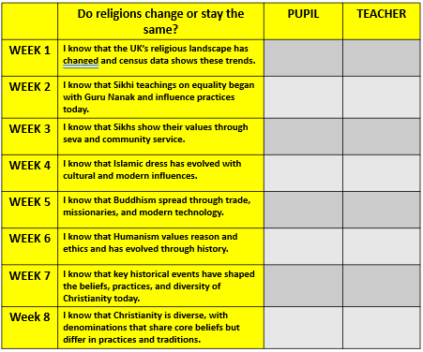


Do religions change or stay the same?
My answer to our topic question:
__________________________________________________________________________________________________________________

Slide 4
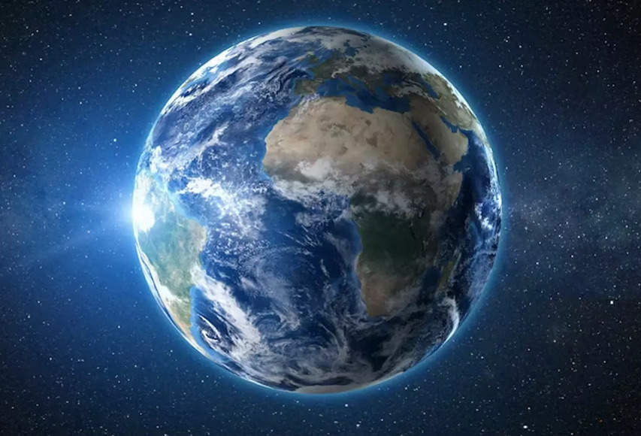
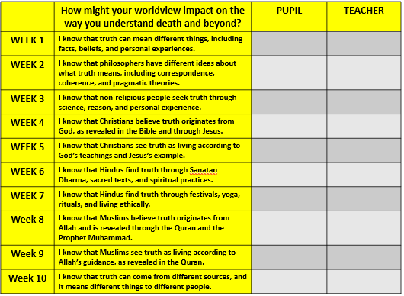
How might your worldview impact on the way you understand death and beyond?
My answer to our topic question:
_______________________________________________________________________________________________________________________________________________________________________________________________________________________________________

