Slide 1
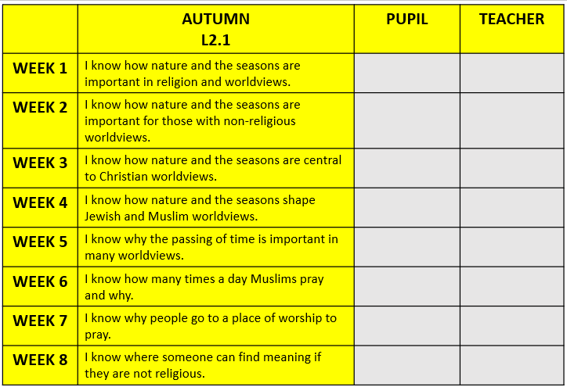
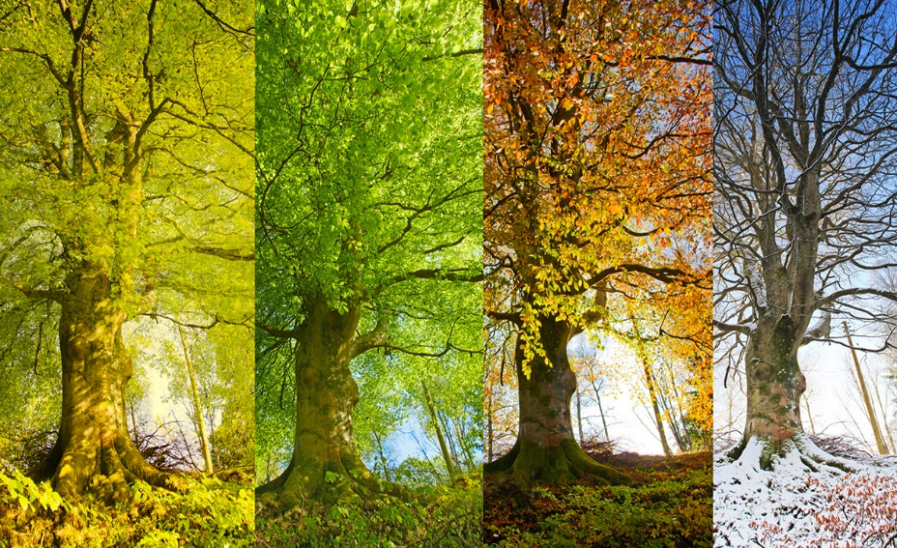




Why are nature and the seasons significant for religion and worldviews?
My answer to our topic question:
_______________________________________________________________________________________________________________________________________________________________________________________________________________________________________

Slide 2
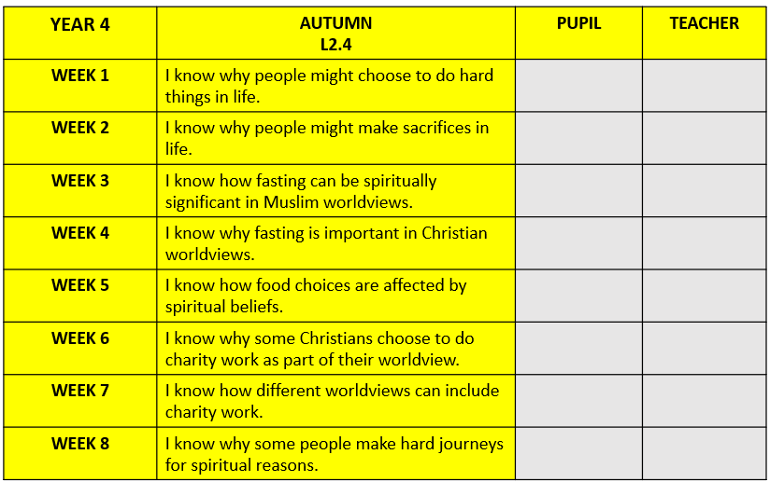
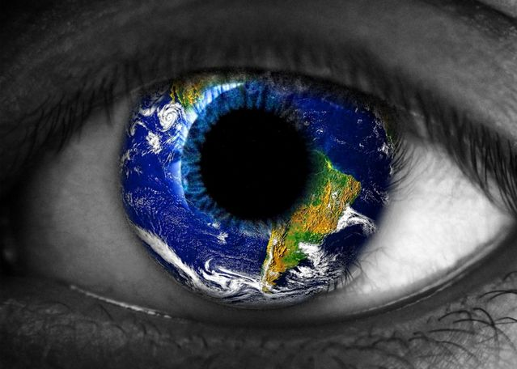

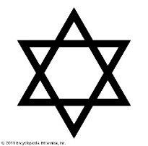


How might your worldview lead you to do hard things for good reasons?
My answer to our topic question:
_______________________________________________________________________________________________________________________________________________________________________________________________________________________________________

Slide 3
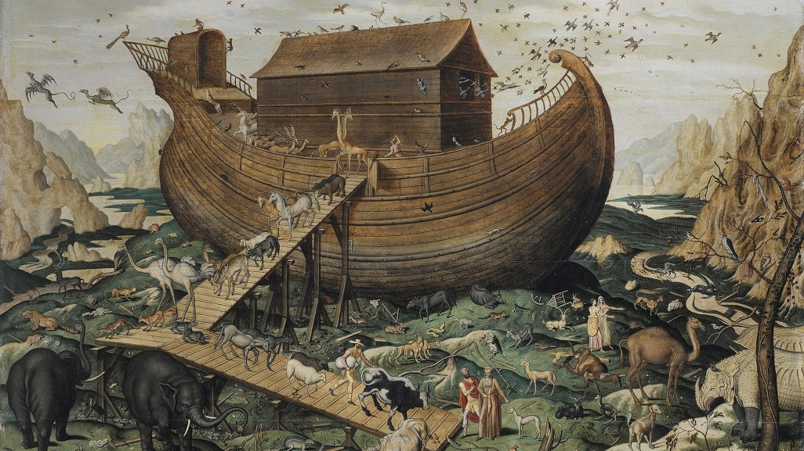
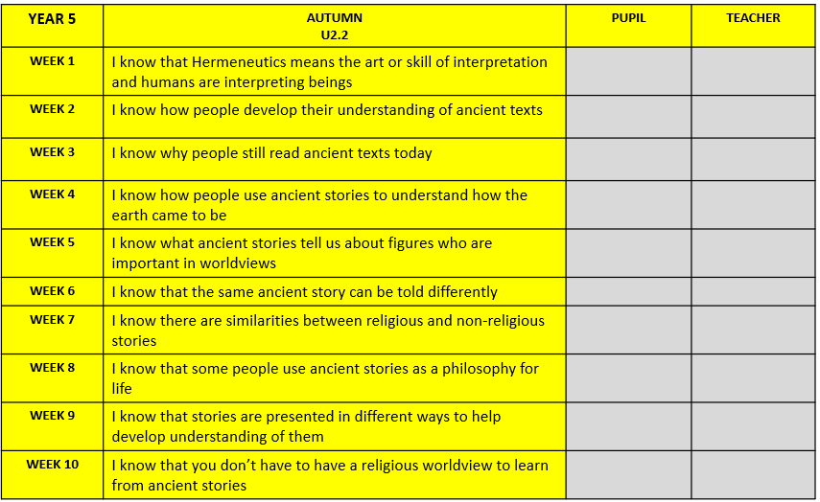

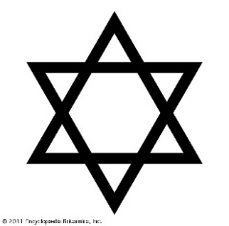
Why might ancient stories still be so important for some worldviews today?
My answer to our topic question:
_______________________________________________________________________________________________________________________________________________________________________________________________________________________________________

Slide 4
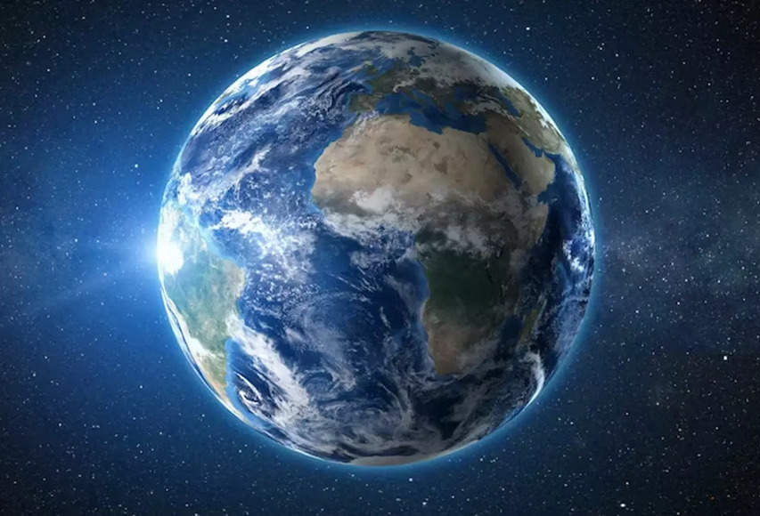
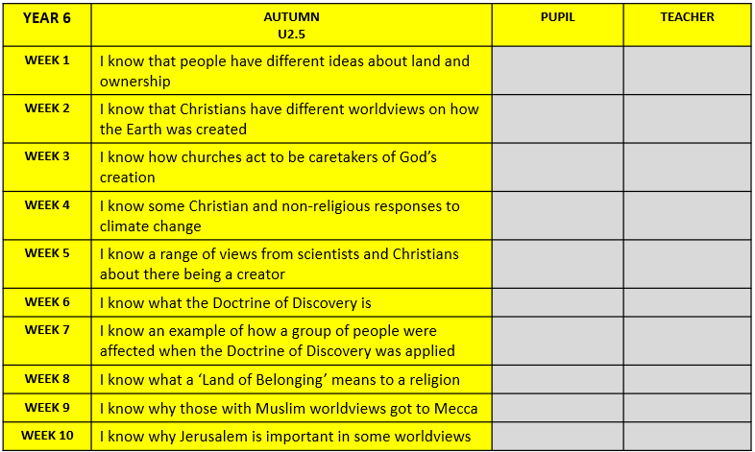
How do beliefs and ideas about land shape the way human beings live?
My answer to our topic question:
_______________________________________________________________________________________________________________________________________________________________________________________________________________________________________

