Slide 1
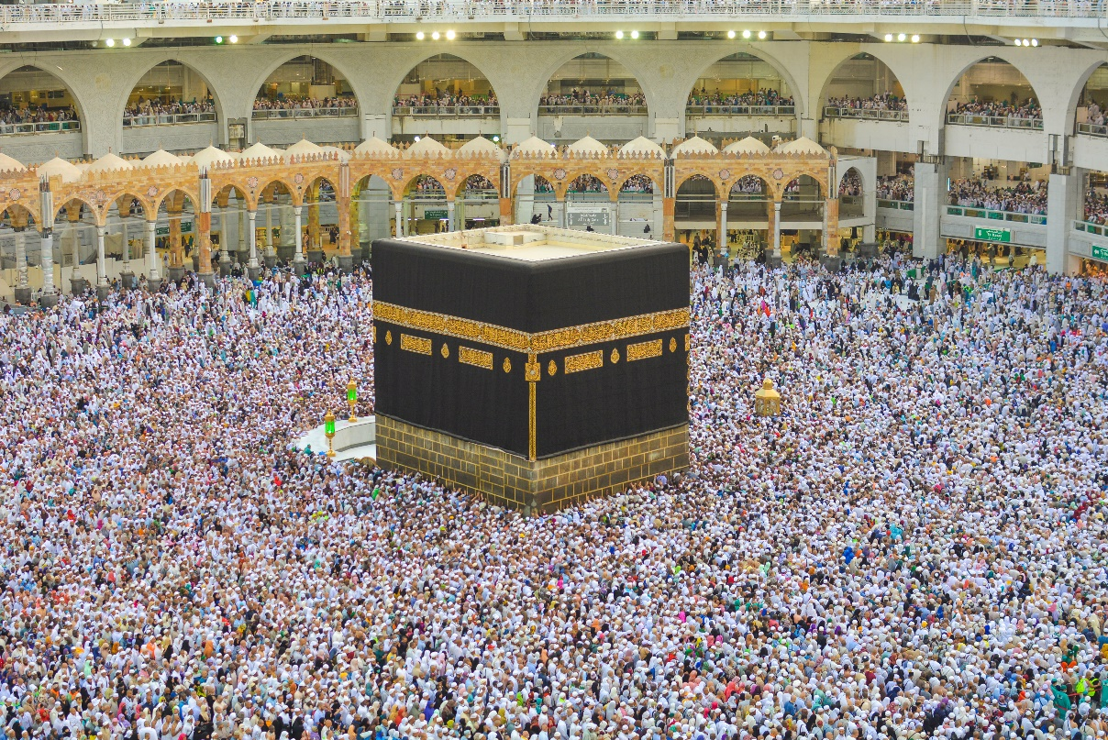

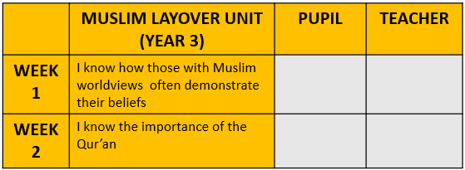
Year 3 Layover Unit – Islam

Slide 2
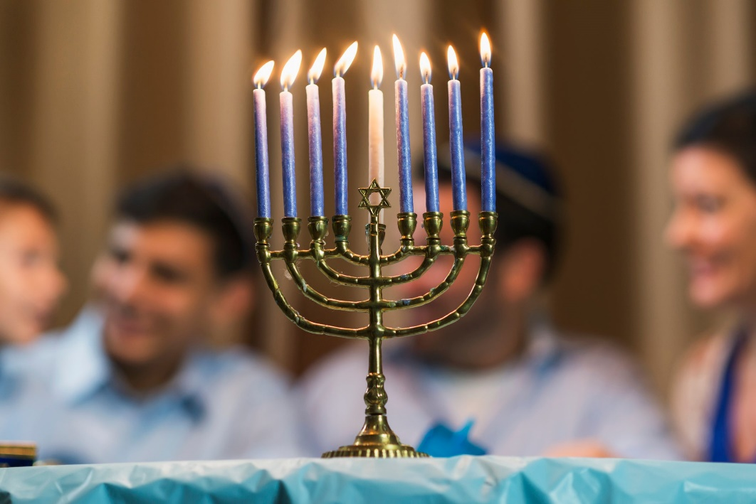

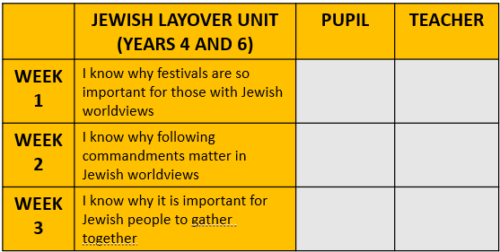
Year 4 Layover Unit – Judaism

Slide 3
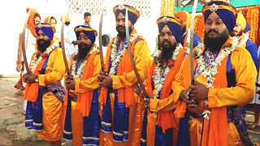

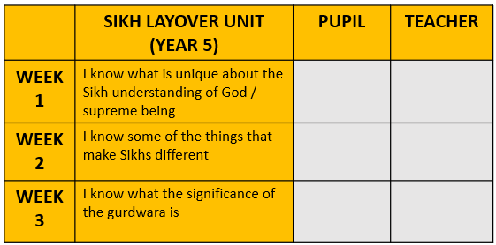
Year 5 Layover Unit – Sikhism

Slide 4
Year 6 Layover Unit – Judaism

