Slide 1
PERSONAL DEVELOPMENT
RSHE
Relationships Education
OTHER ELEMENTS OF PSHE
Wider safety
Economic Understanding
Understanding of technology and media
Sex Education
Physical Health
Mental Well-being
RSHE
Development of character
Confidence and resilience
British Values
Citizenship
Wider opportunities
Inclusion
and Equality of Opportunity
CIEAG (Careers Information, Education, Advice and Guidance)
Spiritual, Moral, Social and Cultural Development

Slide 2
Relationships Education
Jigsaw (PSHE scheme of work) – Units: “Relationships”, “Changing Me”, “Celebrating Difference”, “Dreams and Goals” (respectful relationships), “Healthy Me” (caring friendships)
Purchase of updated scheme Spring 2024 allows access to new resources which meet the RS(H)E curriculum. Senior leader shared with parents:
https://youtu.be/w039hZht2Ss

Slide 3
Sex Education
Jigsaw (PSHE scheme of work) – “Relationships” (all years), “Changing Me” (having a baby Y4, conception and IVF Y5, stages of pregnancy Y6)
Science curriculum – Summer 1 unit “Ch-ch-ch-ch changes” (Year 5)

Slide 4
Physical Health
Jigsaw (PSHE scheme of work) – “Healthy Me” (Exercise and fitness Y4, Healthy diet and body image Y5) “Changing Me” (body image Y5 and Y6)
Science curriculum – “Funny bones” (Nutrition, Y3), “One Digestion” (Digestion, Y4), “Go with the flow” (circulatory system and effects of diet + lifestyle, Y6), “Lettuce eat plants” (Should we eat less meat? Y 6)
Design & Technology curriculum – Summer term units: Healthy eating, healthy diet (Y3 and Y4)
P.E. (PESSPA) curriculum – importance of warming up and cooling down, what happens to our heartrate when we exercise and why is this important? Why does what we eat affect how we can exercise?

Slide 5











Mental Well-being
Primary mental health workshops (external agencies PMHST)
Our school cultures
PSHE curriculum – Jigsaw + Growth mindset “Calm me” section in “Healthy Me”, “Relationships”, “Changing Me” and “Celebrating Difference” (perceptions of normality)
Open door policies
Protective behaviours
Interventions (e.g. BEACON)
Y6 survey from Compass (Warwickshire nursing team) – data gathered and feedback workshops offered accordingly e.g. Connect4Health team delivering Y6 workshop about body image and self esteem Spring ‘24 following Aut ‘23 questionnaire
PESSPA (PE) curriculum

Slide 6
OTHER ELEMENTS OF PSHE – Wider Safety
School rule (1/3): Be Safe!
Fire safety workshop annually
Computing curriculum: Internet safety (all years) / Safer Internet Day (Feb, all years)
Safe and active travel awards (WCC)
Road safety awards – e.g. bikeability
Police delivery age-appropriate talks + workshops e.g. Drama group “Loudmouth” on knife crime (Y6)
PSHE Jigsaw curriculum covers substance abuse: “Healthy Me”, basic first aid: “Healthy Me”. Also see “Relationships”, “Changing Me” and “Celebrating Difference”
Protective behaviours
GOAL - selecting areas from: jobs, renting accommodation, fines, politics, driving, mobile phones, online safety, credit and debit cards, managing bills, buying a house, pets, holidays.

Slide 7
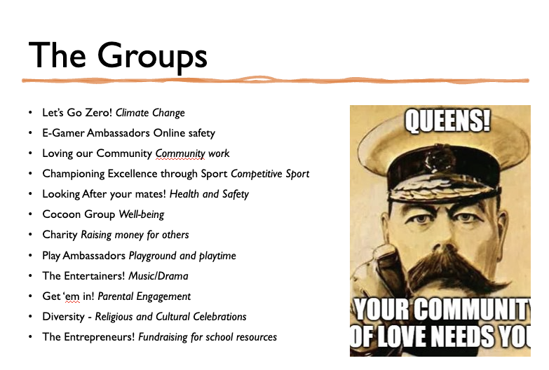
OTHER ELEMENTS OF PSHE –
Economic Understanding
GOAL – see Wider Safety
PSHE curriculum: Jigsaw unit “Dreams and Goals” (simple budgeting Y3, the importance of money, Y5) “Celebrating Difference” (material wealth and happiness Y5)
Leadership groups (12 categories:

Slide 8
OTHER ELEMENTS OF PSHE –
Understanding of Technology and Media
Computing curriculum
Power of advertising – “Let’s say… we are travel agents / exhibitors”
Critique media (English Y6)
Technological safety: Jigsaw units: “Relationships” (online grooming, smart safety rules Y5 and Y6) “Healthy Me” (keeping safe on and offline Y3)

Slide 9
OTHER ELEMENTS OF PSHE –
Other Miscellaneous Elements
Readiness for the next stage in education (PSHE transition unit within Jigsaw, Year 6), meetings with and visits from secondary school teachers, transition days
Celebrations of attendance and punctuality
Effective pastoral support (x7 DSLs, Attendance and Pastoral Leader, Tas specific to pastoral needs)
Varieties within the curriculum so that all pupils, including those with SEND, have access to an engaging curriculum (e.g. Maths4Life)
Residential (Y6)
After school provision is free for many
Extra curricular clubs

Slide 10

CITIZENSHIP
Leadership groups e.g. community
Courageous advocacy
Reading lessons
Curriculum inspirations
Collective worship
PSHE curriculum: Jigsaw “Relationships” (Summer 1 unit, all years), “Dreams and Goals” (Summer 2 unit, all years)
Oracy
Presence in the community – charity work, local trips (e.g. mosque)
Students from NWHC come in and talk to parents
Curriculum workshops for parents – support videos sent out

Slide 11
DEVELOPMENT OF CHARACTER –
Confidence and Resilience
Our vision and cultures
Role models in school
Science curriculum
Learning and taking inspiration from the Greats
Curriculum inspirations
History and Geography curriculum: “Botheredness” (“Let’s say…” getting children invested and becoming independent learners)
Charity work – donations to food bank, providing food hampers at Christmas

Slide 12
Wider Opportunities
Range of clubs (sport, chess, choir, team building)
Musical performances (choir)
MAT sports
Junior PCSO
Additional music lessons (peripatetic)
Residential (Year 6)
Trips and visitors
Librarians
Ambassadors
Leadership groups (see Economic Understanding)

Slide 13
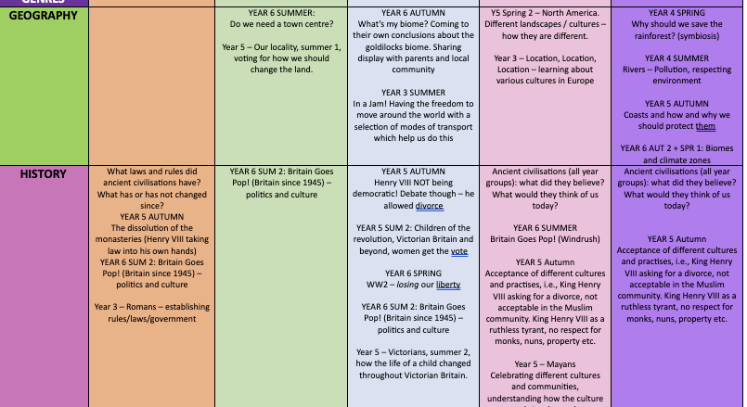

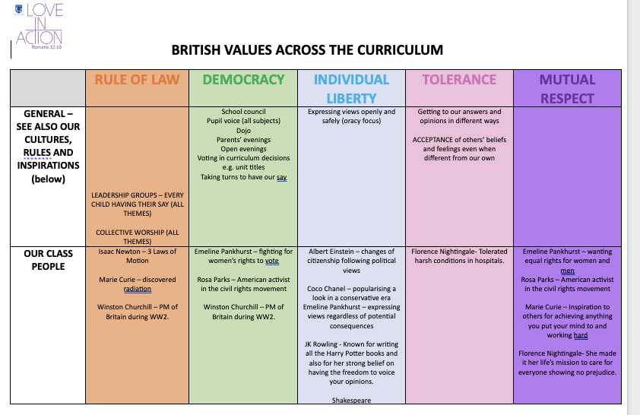
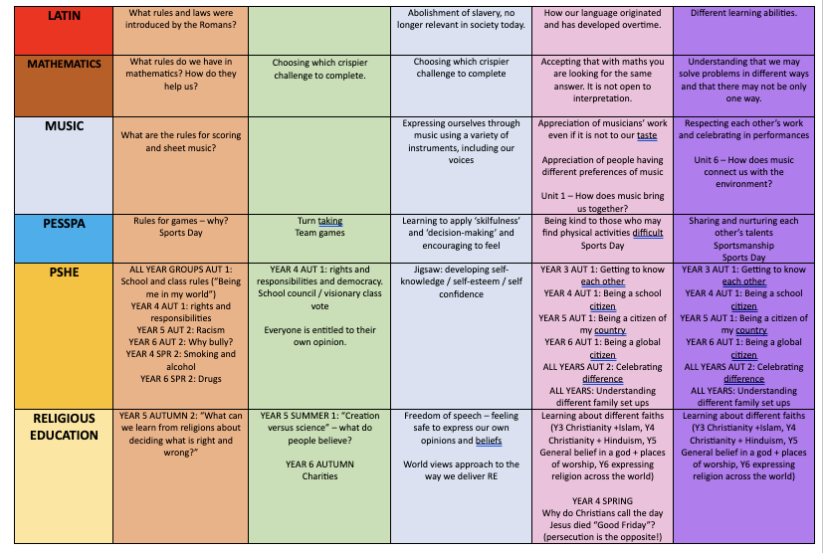
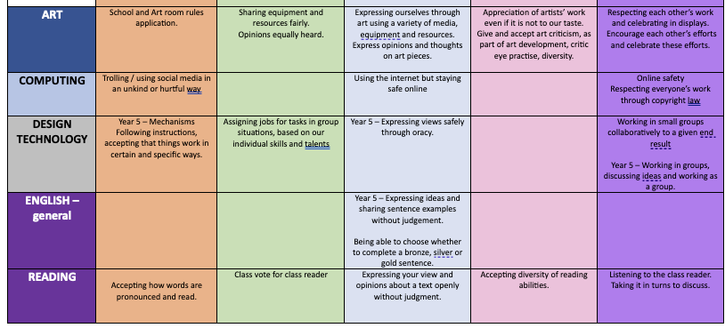
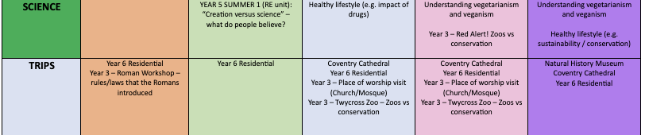
British Values
Displayed in classrooms
Taught explicitly in lessons where relevant
Added to topic displays
Annotated on planning
Large display in school (wraps)
*See British Values policy

Slide 14
Protected characteristics
Access to everything school has offer regardless of: gender, gender reassignment, race, colour, age, creed, disability.
See behaviour policy, antibullying policy, equality and diversity policy, SEND policy

Slide 15
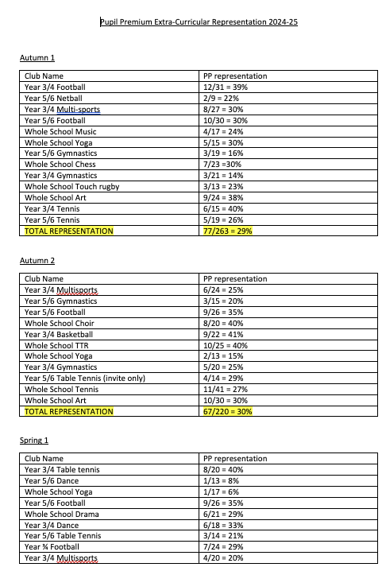
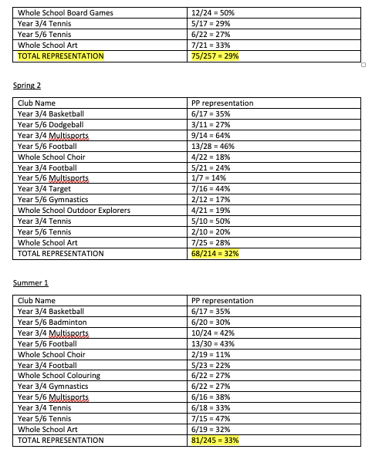
Inclusion and Equality of Opportunity

Slide 16
CIEAG (Careers Information, Education, Advice and Guidance)
GOAL – see “Wider Safety”
Enterprise week
Computing curriculum: Careers and Aspirations (Summer 2, all years)
PSHE Jigsaw curriculum “Dreams and Goals” (all years)

Slide 17
Spiritual, Moral, Social and Cultural Development
R.E curriculum
Empathy: “Let’s say…” curriculum in Humanities (moral stance)
Cultures e.g.
Inspirations
Trips and visitors

