Slide 1
Instructions
The first row of words are from previous topics or in the case of year 3, from Key stage 1. This should enable all children to colour some of their grid in green.
The middle row (and one or two of bottom row) are the new words for this topic
The remaining 3 or 4 words might only be picked up by GDS pupils. Ensure that anybody colouring these green proves that they can use the words by writing it in the Vocabulary in Action section.

Slide 2
Tomb Raiders
Vocabulary Words I Know (beginning of topic)
Artefacts | Archaeologist |  | Treasure | Pyramid |  | Farming
Ancient | BC (BCE) |  | Civilisation | Tomb |  | Belief
Primary Source | Pharaoh |  | Sarcophagus | Hieroglyph
I don’t know it |  | I know what it means |  |  | I can use it in a sentence
Vocabulary Words I Know (end of topic)
Artefacts | Archaeologist |  | Treasure | Pyramid |  | Farming
Ancient | BC (BCE) |  | Civilisation | Tomb |  | Belief
Primary Source | Pharaoh |  | Sarcophagus | Hieroglyph
I don’t know it |  | I know what it means |  |  | I can use it in a sentence
Vocabulary In Action
________________________________________________________________________________________________________________________________________________________________________________________________________________________________________________________________________________________ ________________________________________

Slide 3
Dragon Slayers
Vocabulary Words I Know (beginning of topic)
Invade | Settle (ment) |  | Kingdom | Christian(ity) |  | Pagans
Viking | Anglo-Saxon |  | Danelaw | Monastery |  | Conversion
Scandinavia | Conflict |  | Resistance | Partition |  | Polytheistic
I don’t know it |  | I know what it means |  |  | I can use it in a sentence
Vocabulary Words I Know (end of topic)
Invade | Settle (ment) |  | Kingdom | Christian(ity) |  | Pagans
Viking | Anglo-Saxon |  | Danelaw | Monastery |  | Conversion
Scandinavia | Conflict |  | Resistance | Partition |  | Polytheistic
I don’t know it |  | I know what it means |  |  | I can use it in a sentence
Vocabulary In Action
________________________________________________________________________________________________________________________________________________________________________________________________________________________________________________________________________________________ ________________________________________

Slide 4
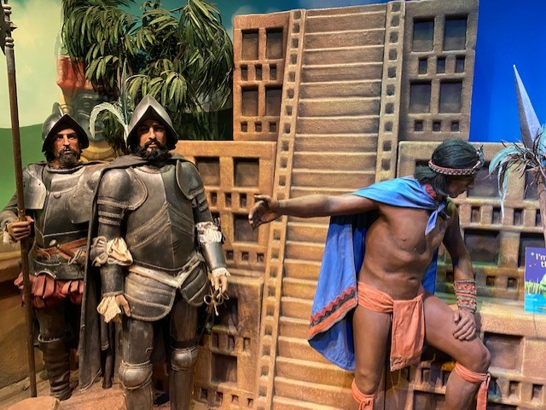



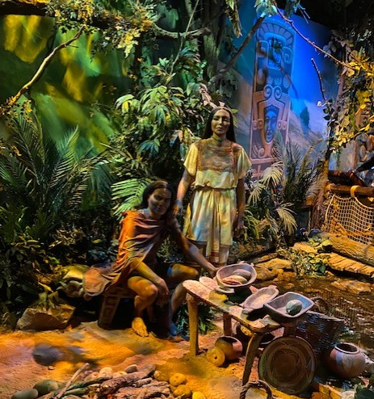
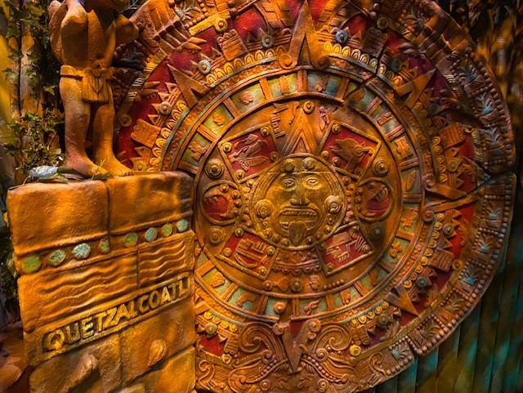
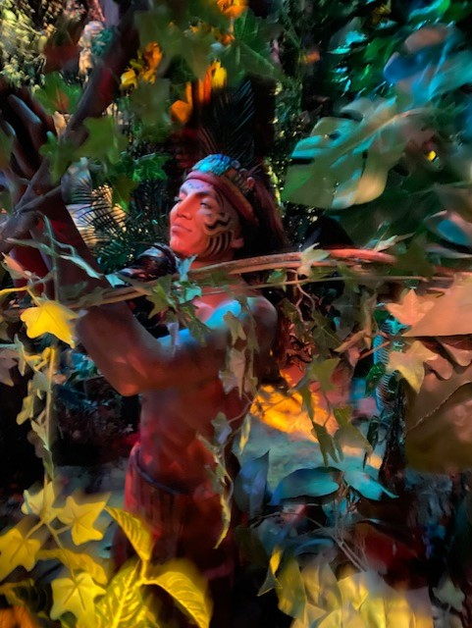
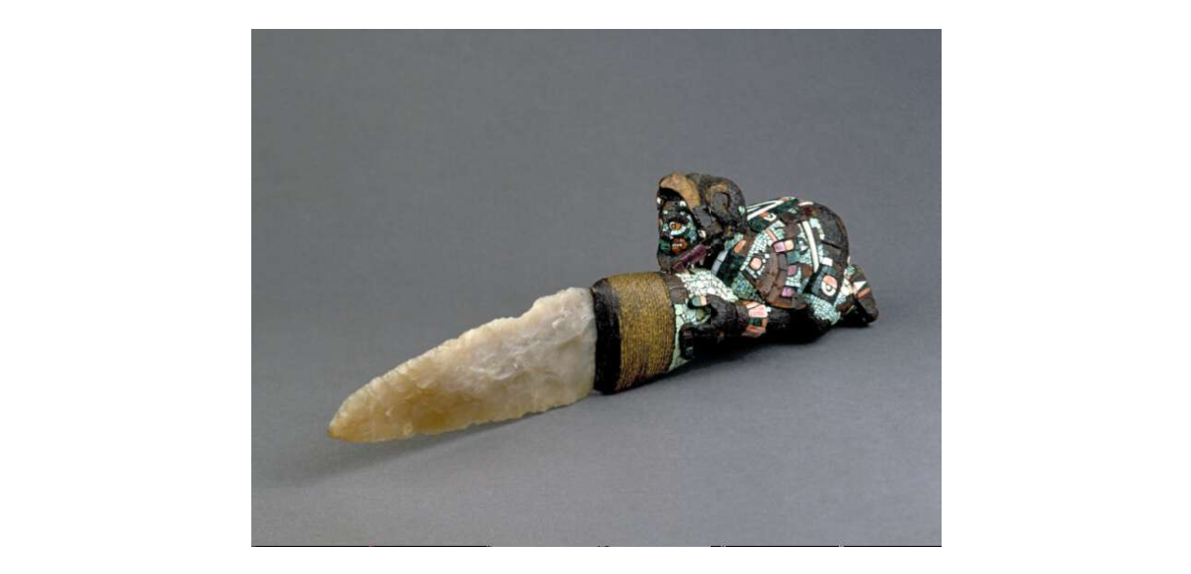
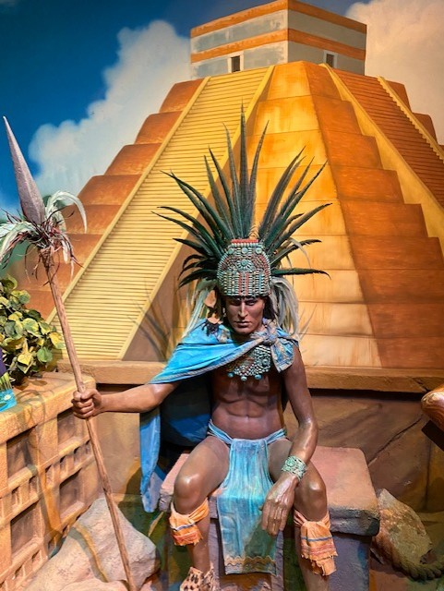
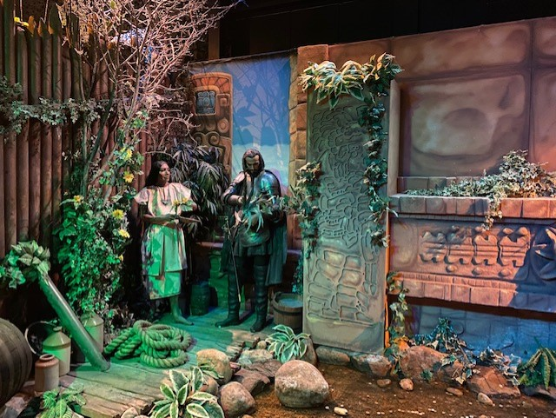

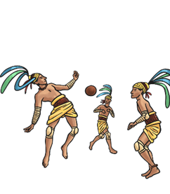
America: Is it all Mayan?
Vocabulary Words I Know (beginning of topic)
Civilisation | Invasion |  | Pyramid | Temple |  | Worship
Society | Conquest |  | Culture | Maya/ Aztec |  | Sacrifice
Hierarchy | Colonise |  | Propaganda | Indig- enous |  | Ritual
I don’t know it |  | I know what it means |  |  | I can use it in a sentence
Vocabulary Words I Know (end of topic)
Civilisation | Invasion |  | Pyramid | Temple |  | Worship
Society | Conquest |  | Culture | Maya/ Aztec |  | Sacrifice
Hierarchy | Colonise |  | Propaganda | Indig- enous |  | Ritual
I don’t know it |  | I know what it means |  |  | I can use it in a sentence
Vocabulary In Action
________________________________________________________________________________________________________________________________________________________________________________________________________________________________________________________________________________________ ________________________________________

Slide 5


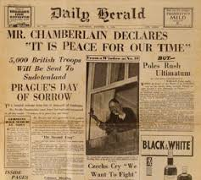
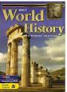

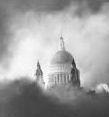


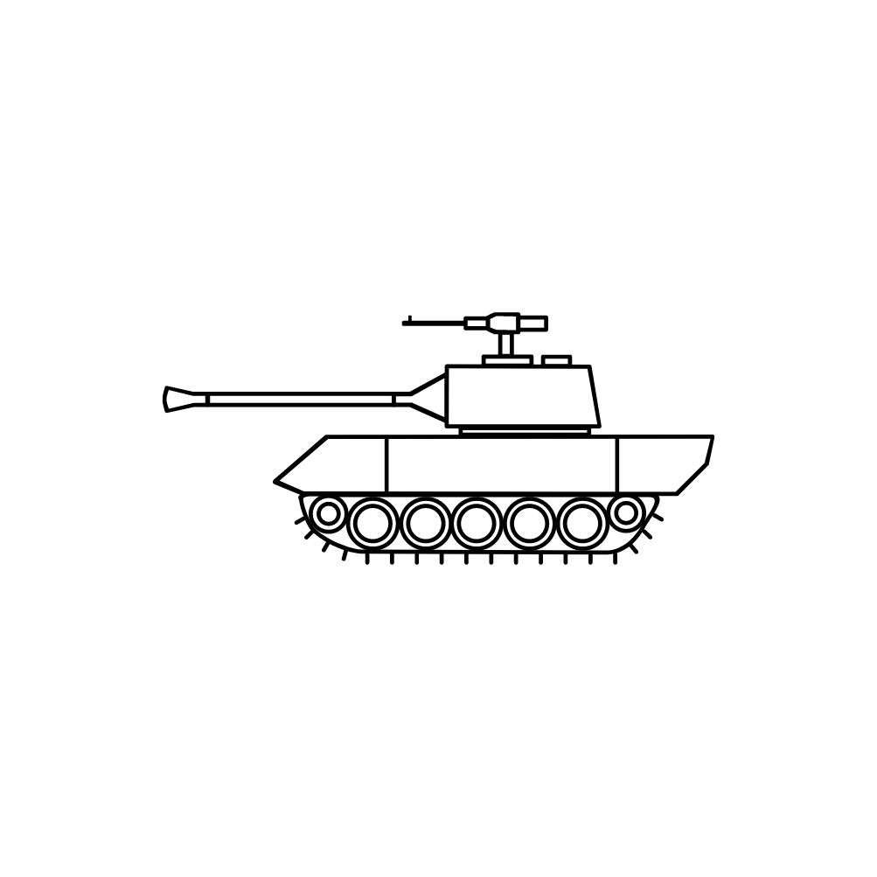

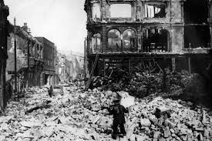

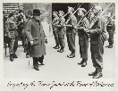

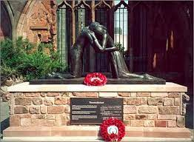
Without War-Ning…
Vocabulary Words I Know (beginning of topic)
Air-raid | Soldiers |  | Primary Sources | Secondary Sources |  | Factories
Blitz | Evacuees |  | Propaganda | Rations |  | Armaments
Total war | Civilians |  | Morale | Home Front |  | Reconcil -iation
I don’t know it |  | I know what it means |  |  | I can use it in a sentence
Vocabulary Words I Know (end of topic)
Air-raid | Soldiers |  | Primary Sources | Secondary Sources |  | Factories
Blitz | Evacuees |  | Propaganda | Rations |  | Armaments
Total war | Civilians |  | Morale | Home Front |  | Reconcil -iation
I don’t know it |  | I know what it means |  |  | I can use it in a sentence
Vocabulary In Action
________________________________________________________________________________________________________________________________________________________________________________________________________________________________________________________________________________________ ________________________________________

