Slide 1
Instructions
The first row of words are from previous topics or in the case of year 3, from Key stage 1. This should enable all children to colour some of their grid in green.
The middle row (and one or two of bottom row) are the new words for this topic
The remaining 3 or 4 words might only be picked up by GDS pupils. Ensure that anybody colouring these green proves that they can use the words by writing it in the Vocabulary in Action section.

Slide 2








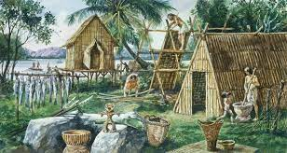
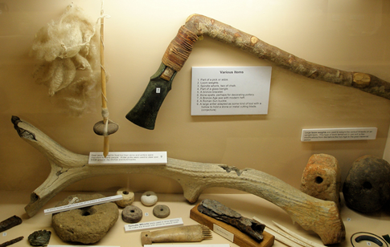



Adventures of Early Man
Vocabulary Words I Know (beginning of topic)
History | Evidence |  | Age | Farmers |  | Cave
Prehistoric | Archaeology |  | Period | Hunter-gatherers |  | Settle- ment
Artefacts | Primary Sources |  | Stone Age | Bronze Age |  | Iron Age
I don’t know it |  | I know what it means |  |  | I can use it in a sentence
Vocabulary Words I Know (end of topic)
History | Evidence |  | Age | Farmers |  | Cave
Prehistoric | Archaeology |  | Period | Hunter-gatherers |  | Settle- ment
Artefacts | Primary Sources |  | Stone Age | Bronze Age |  | Iron Age
I don’t know it |  | I know what it means |  |  | I can use it in a sentence
Vocabulary In Action
________________________________________________________________________________________________________________________________________________________________________________________________________________________________________________________________________________________ ________________________________________

Slide 3






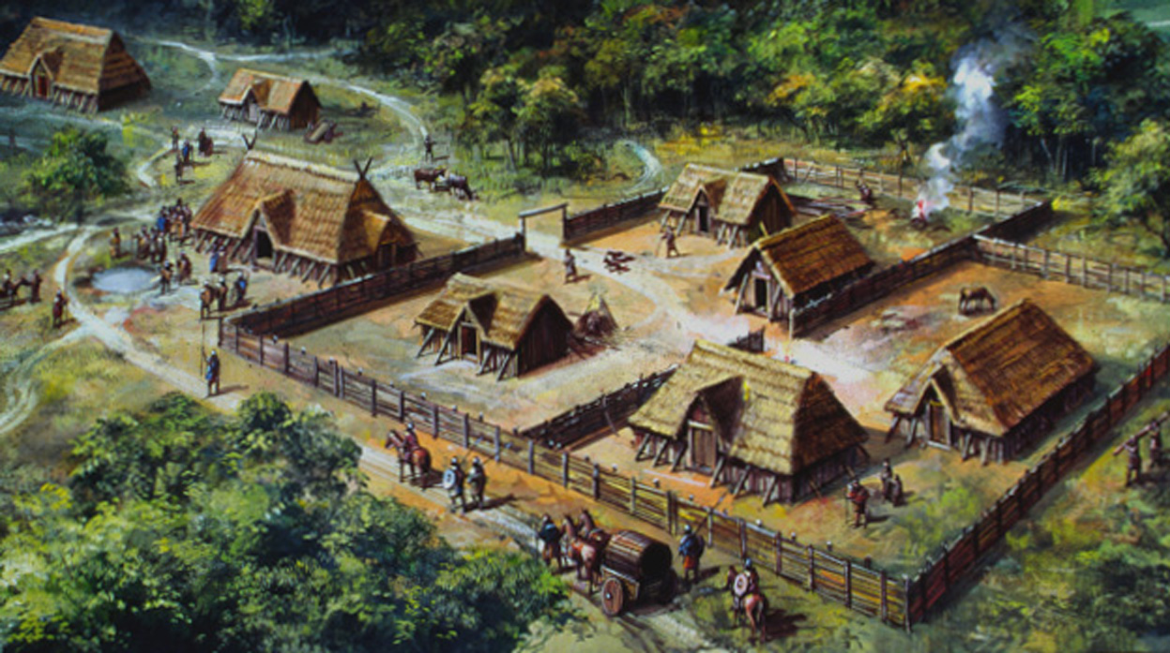



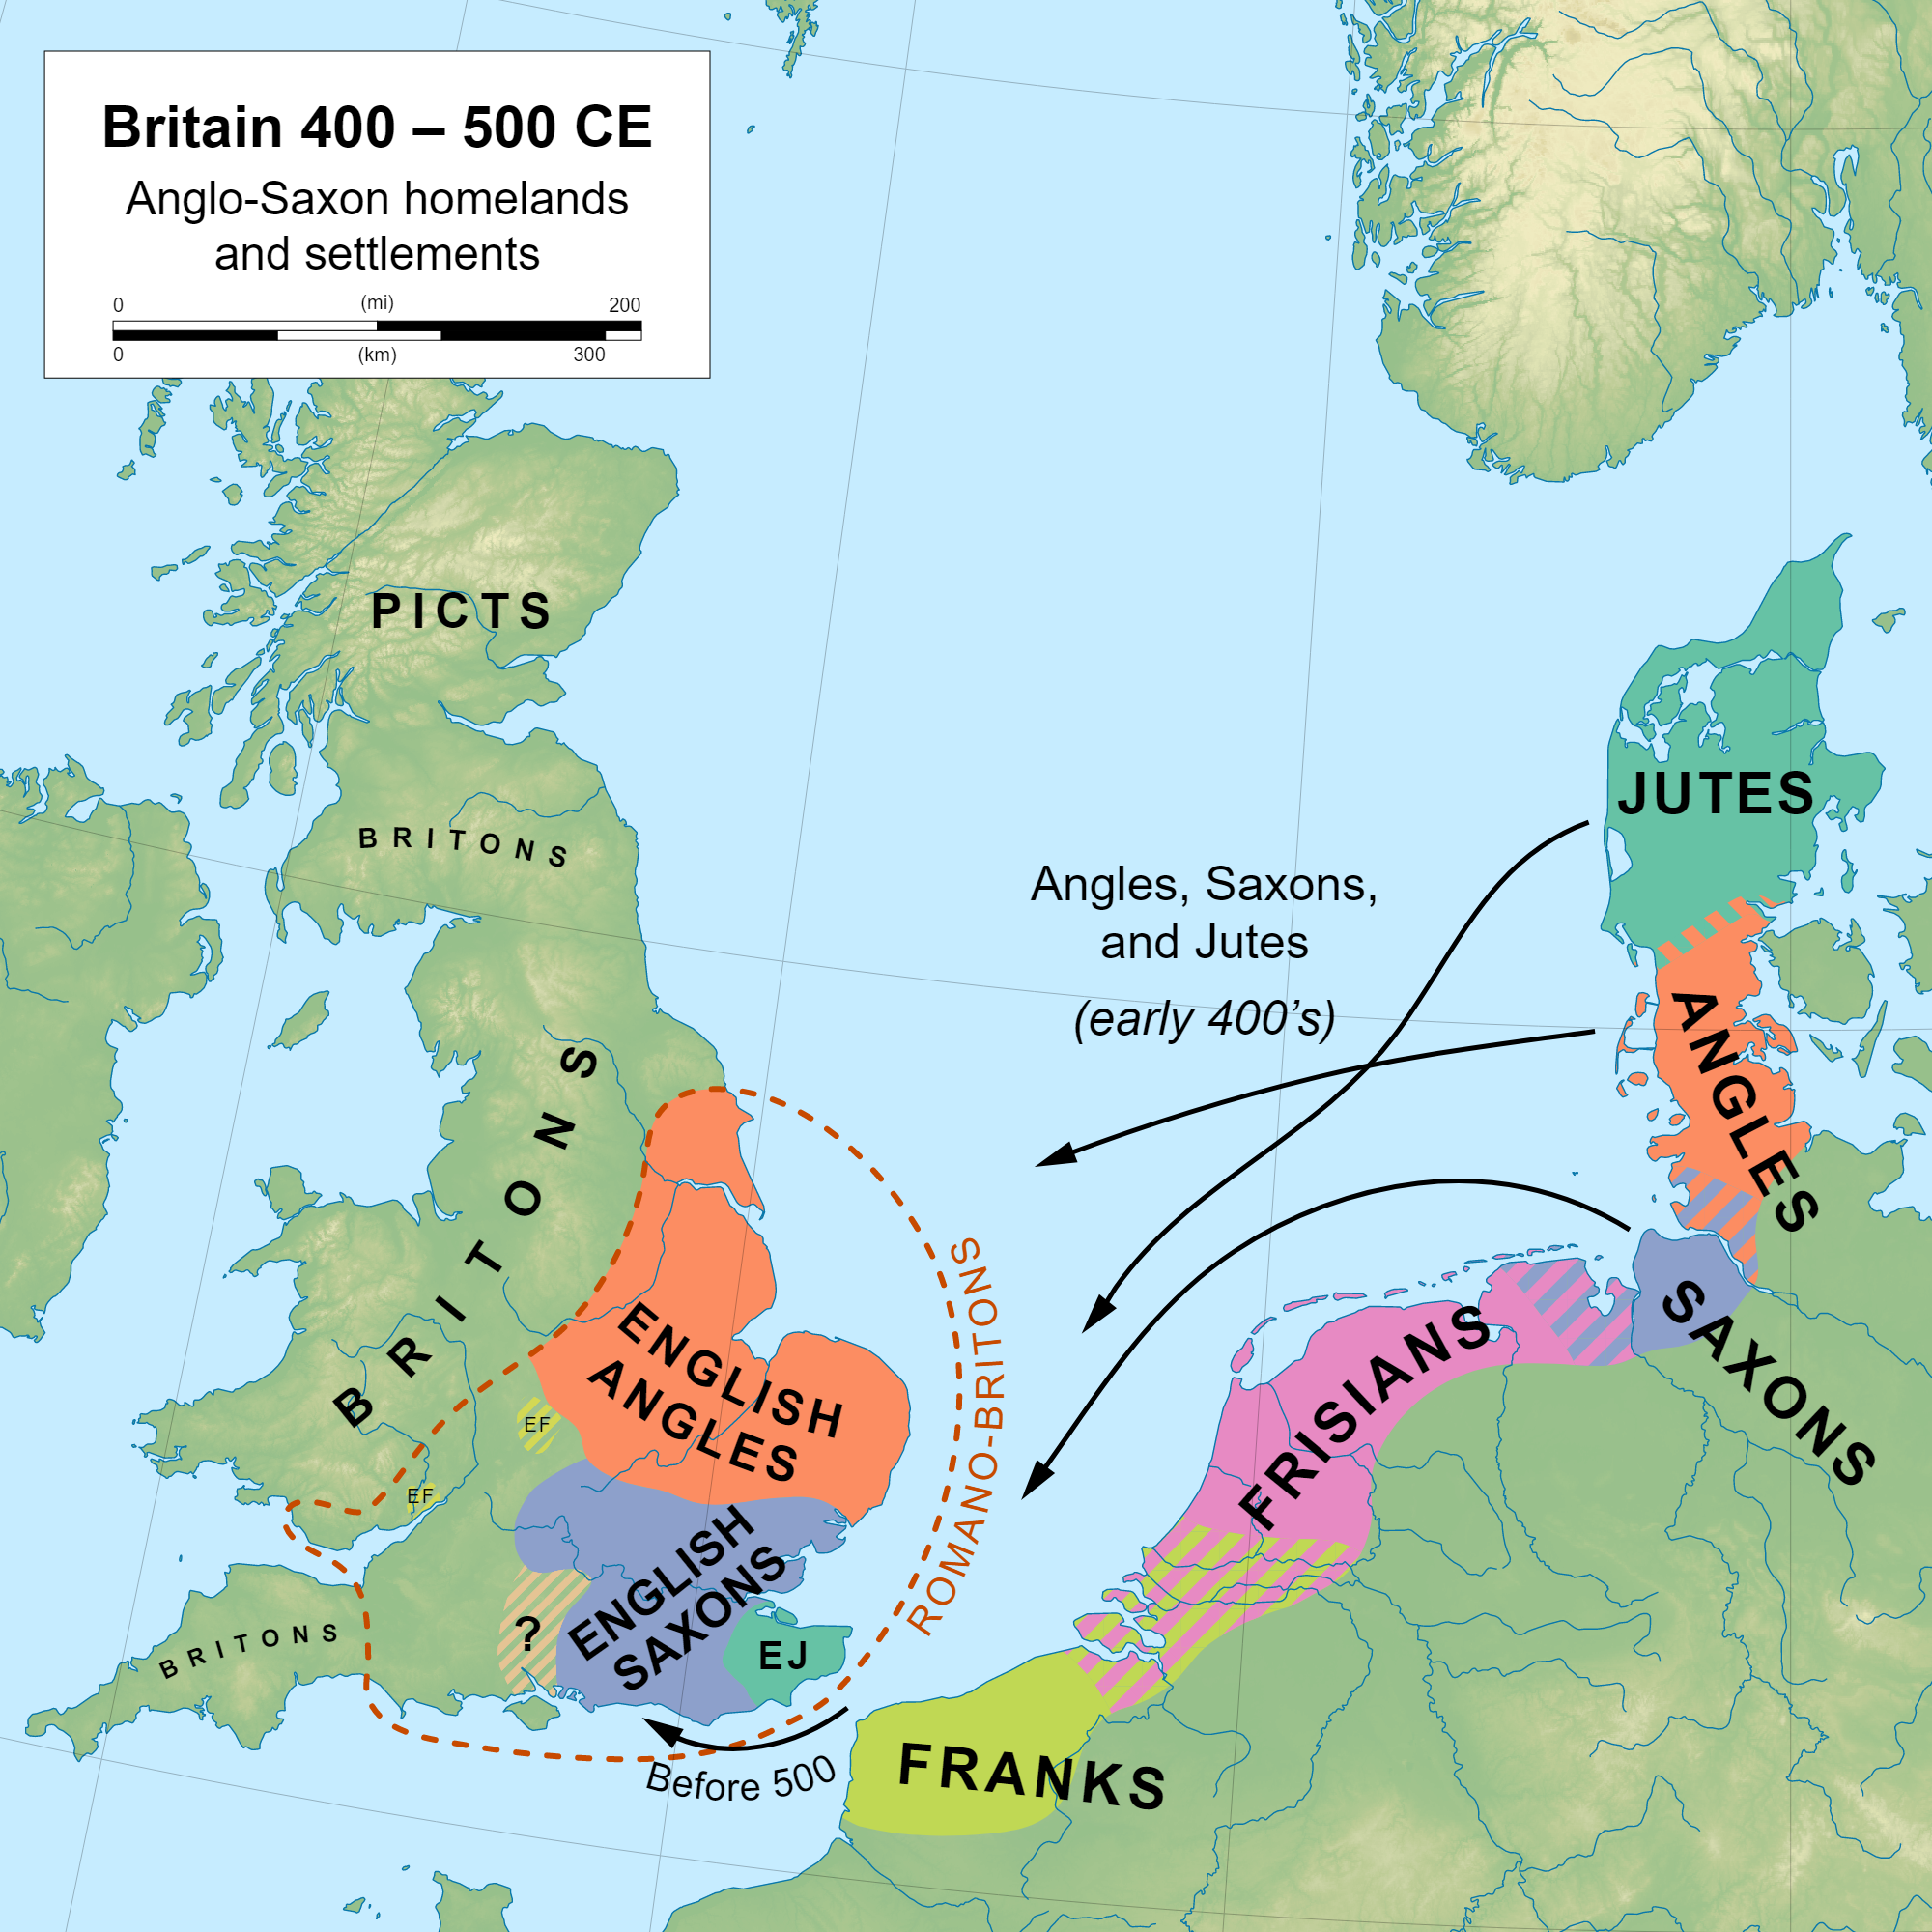


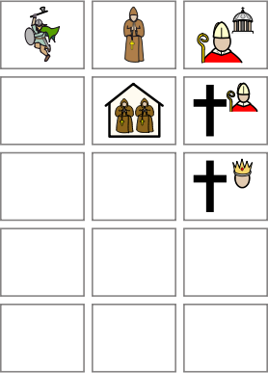

Angles to Angels
Vocabulary Words I Know (beginning of topic)
Invasion | Settlement |  | Christianity | Kingdom |  | Beliefs
Saxons, Angles, Jutes | Town/ Village |  | Anglo-Saxon | Society |  | Pagan
Germanic | Conversion |  | Missionary | Pope |  | Polytheistic
I don’t know it |  | I know what it means |  |  | I can use it in a sentence
Vocabulary Words I Know (end of topic)
Invasion | Settlement |  | Christianity | Kingdom |  | Beliefs
Saxons, Angles, Jutes | Town/ Village |  | Anglo-Saxon | Society |  | Pagan
Germanic | Conversion |  | Missionary | Pope |  | Polytheistic
I don’t know it |  | I know what it means |  |  | I can use it in a sentence
Vocabulary In Action
________________________________________________________________________________________________________________________________________________________________________________________________________________________________________________________________________________________ ________________________________________

Slide 4
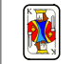

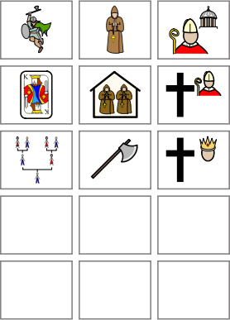

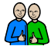
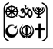
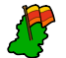

Too Much of a Good King!
Vocabulary Words I Know (beginning of topic)
Chronological | Dissolution |  | Monk | Monarch |  | Pope
Medieval | Dynasty |  | Monastery | Tyrant |  | Roman Catholic
Reformation | Alliance |  | Religious | Political |  | Protestant
I don’t know it |  | I know what it means |  |  | I can use it in a sentence
Vocabulary Words I Know (end of topic)
Chronological | Warrior |  | Monk | Monarch |  | Pope
Medieval | Dynasty |  | Monastery | Tyrant |  | Roman Catholic
Reformation | Alliance |  | Religious | Political |  | Protestant
I don’t know it |  | I know what it means |  |  | I can use it in a sentence
Vocabulary In Action
________________________________________________________________________________________________________________________________________________________________________________________________________________________________________________________________________________________ ________________________________________

Slide 5
Greece is the word!
Vocabulary Words I Know (beginning of topic)
Ancient | BC (BCE) |  | Civilisation | Temple |  | Myth / Mythical
Legacy | Architecture |  | Olympiad | Parthenon |  | Classical Period
Polytheistic | Democracy |  | Culture | Beliefs |  | Philosophy
I don’t know it |  | I know what it means |  |  | I can use it in a sentence
Vocabulary Words I Know (end of topic)
Ancient | BC (BCE) |  | Civilisation | Temple |  | Myths
Legacy | Architecture |  | Olympiad | Parthenon |  | Classical Period
Polytheistic | Democracy |  | Culture | Beliefs |  | Philosophy
I don’t know it |  | I know what it means |  |  | I can use it in a sentence
Vocabulary In Action
________________________________________________________________________________________________________________________________________________________________________________________________________________________________________________________________________________________ ________________________________________

