Slide 1
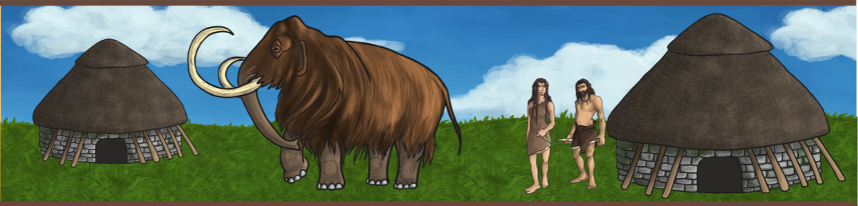
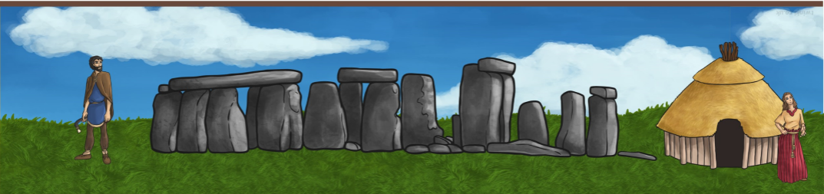
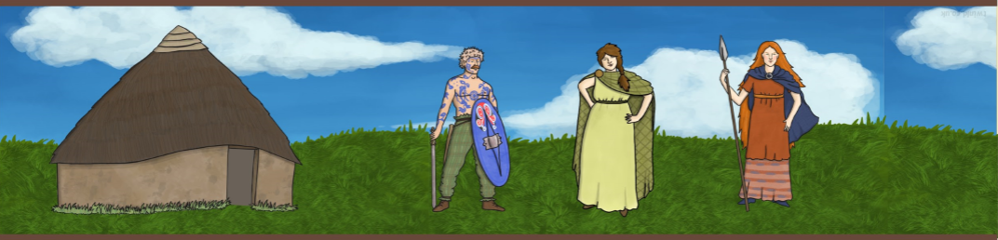
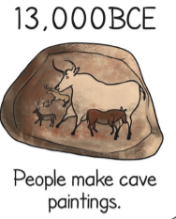
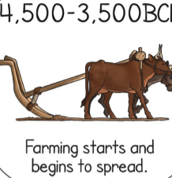
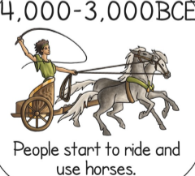
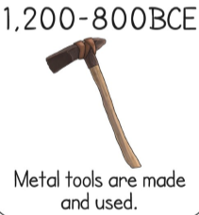
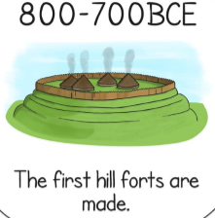
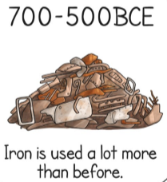
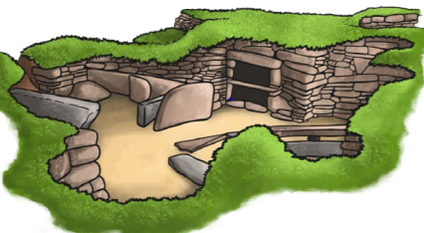
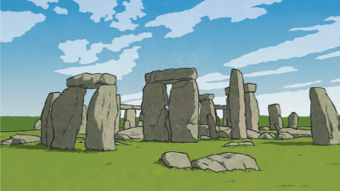
Prehistoric Britain, from the Stone Age to the Iron Age
 | YEAR 3 AUTUMN : THE STONE AGE “Adventures of Early Man” | PUPIL | TEACHER
WEEK 1 | I know that early man created cave paintings to depict meaning
WEEK 2 | I know how long ago the Stone Age was and can mark it on a timeline
WEEK 3 | I know what kinds of tools early man used
WEEK 4 | I can identify and label a typical settlement from the Stone Age
WEEK 5 | I understand how the Stone Age developed into the Bronze Age and how they are different
WEEK 6 | I know that Stonehenge was built during the Bronze Age and can suggest why it was built
Big Question:
How do we know about the first people who lived in Britain?
____________________________________________________________________________________
Can you name these prehistoric sites?

Slide 2
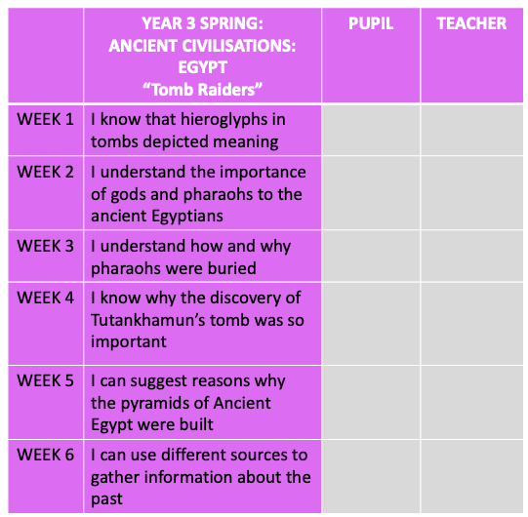
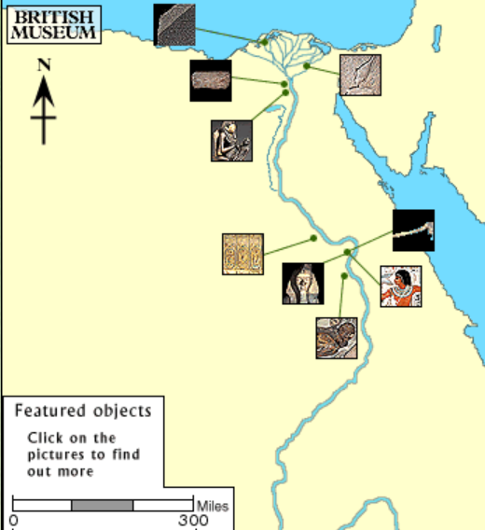
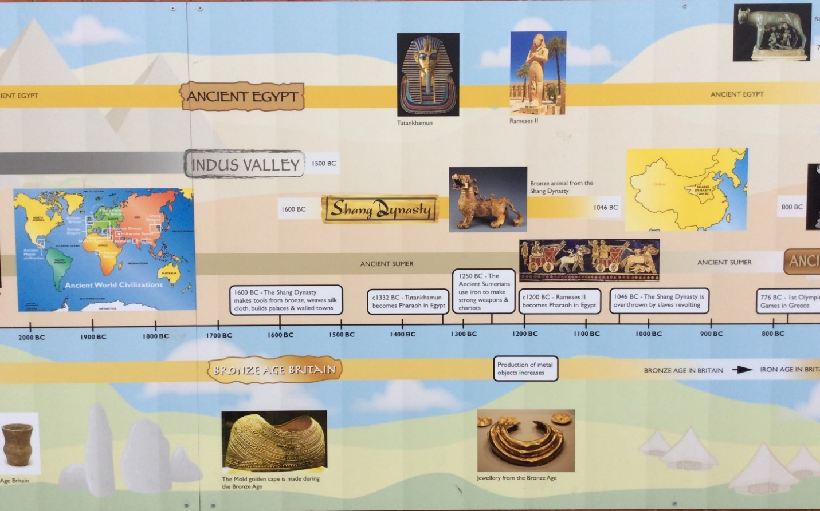

Ancient Egypt
The Big Question: What was Howard Carter looking for?
____________________________________________________________________________________________________________________________________________________________________________________________________________________________________________
____________________________________________________________________________________________________________________________________________________________________________________________________________________________________________

Slide 3
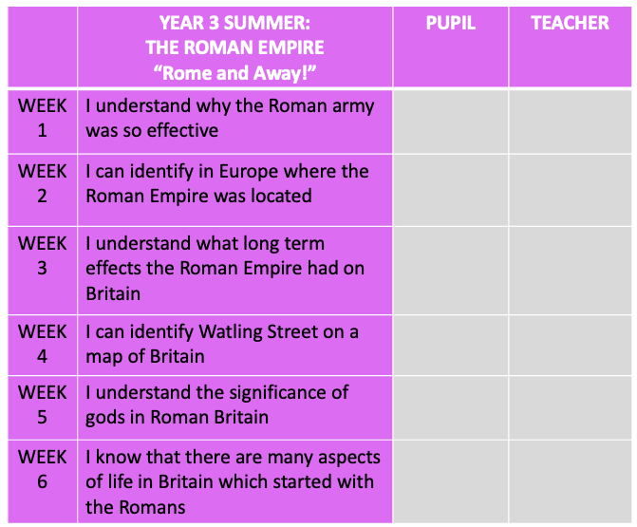
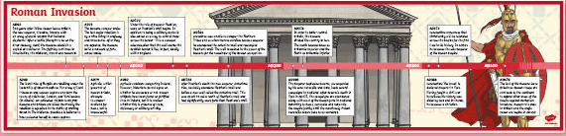
Roman Britain 55BC - 410AD
The Big Question:
What did the Romans do for Britain?
________________________________________________________________________________________________________________________________________________________________________________________

Slide 4
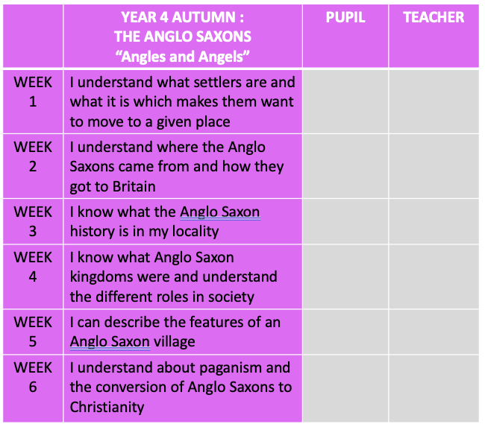
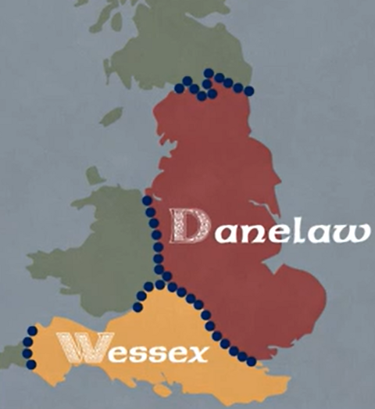
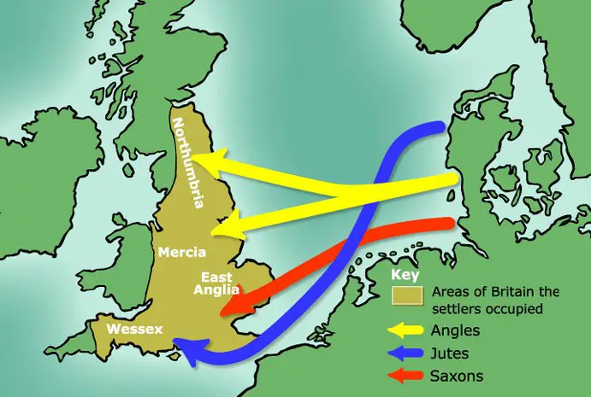
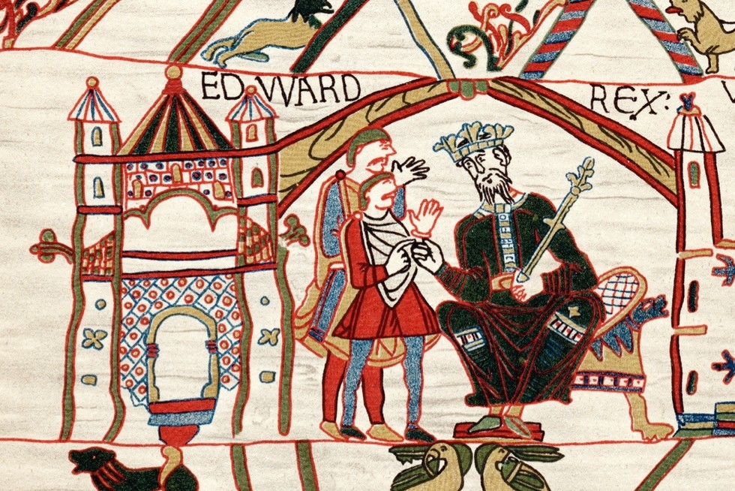
The Anglo Saxons
The Big Question: How did the Anglo-Saxons change Britain?
__________________________________________________
__________________________________________________
___________________________________________________________________________
_______________________________________________________________________________________________________________________________________________________________________________

Slide 5
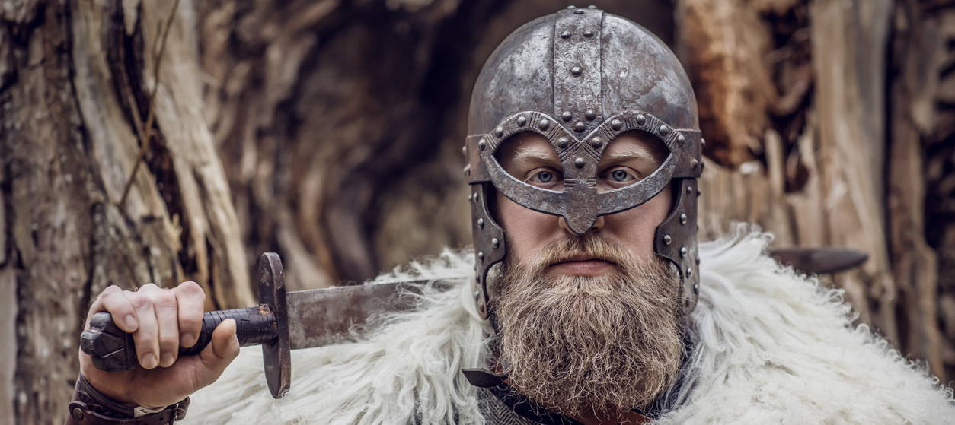
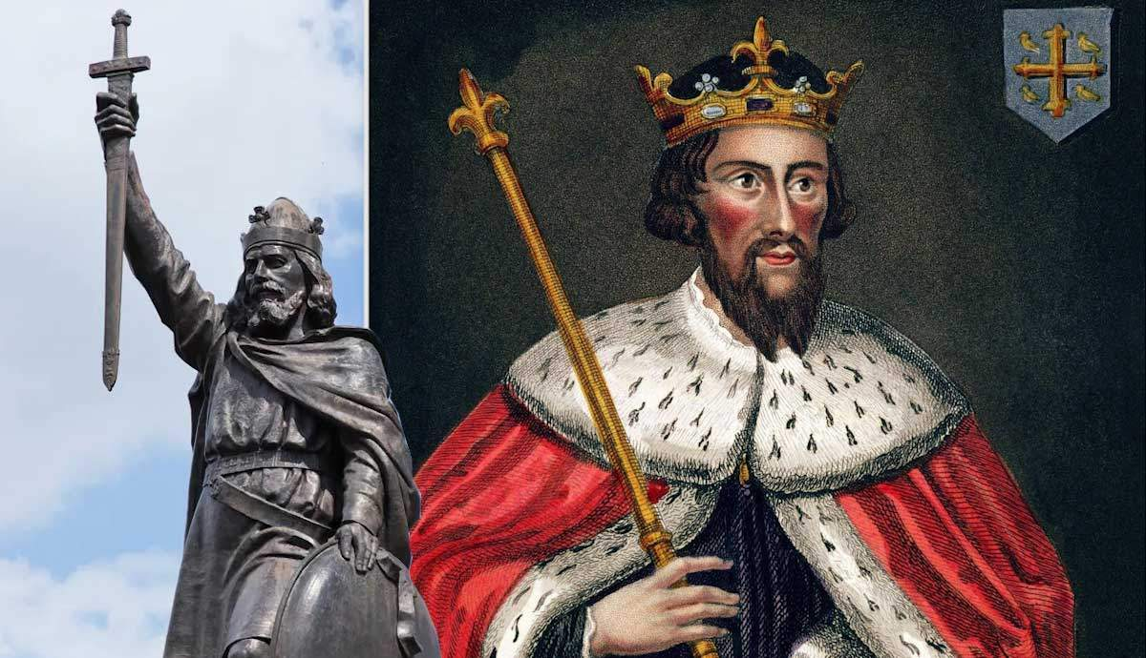
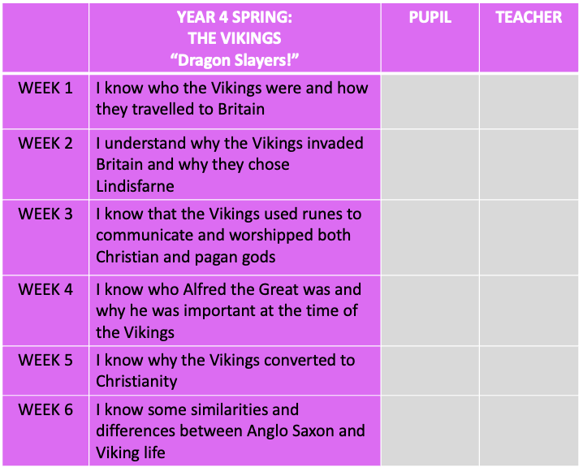
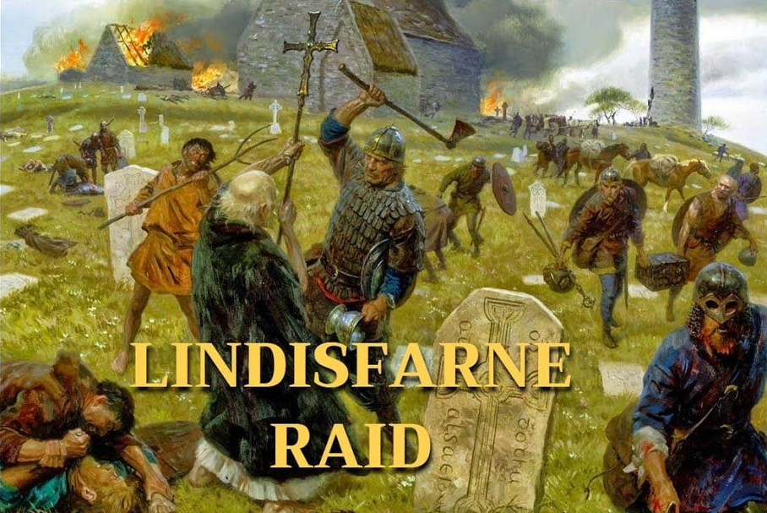
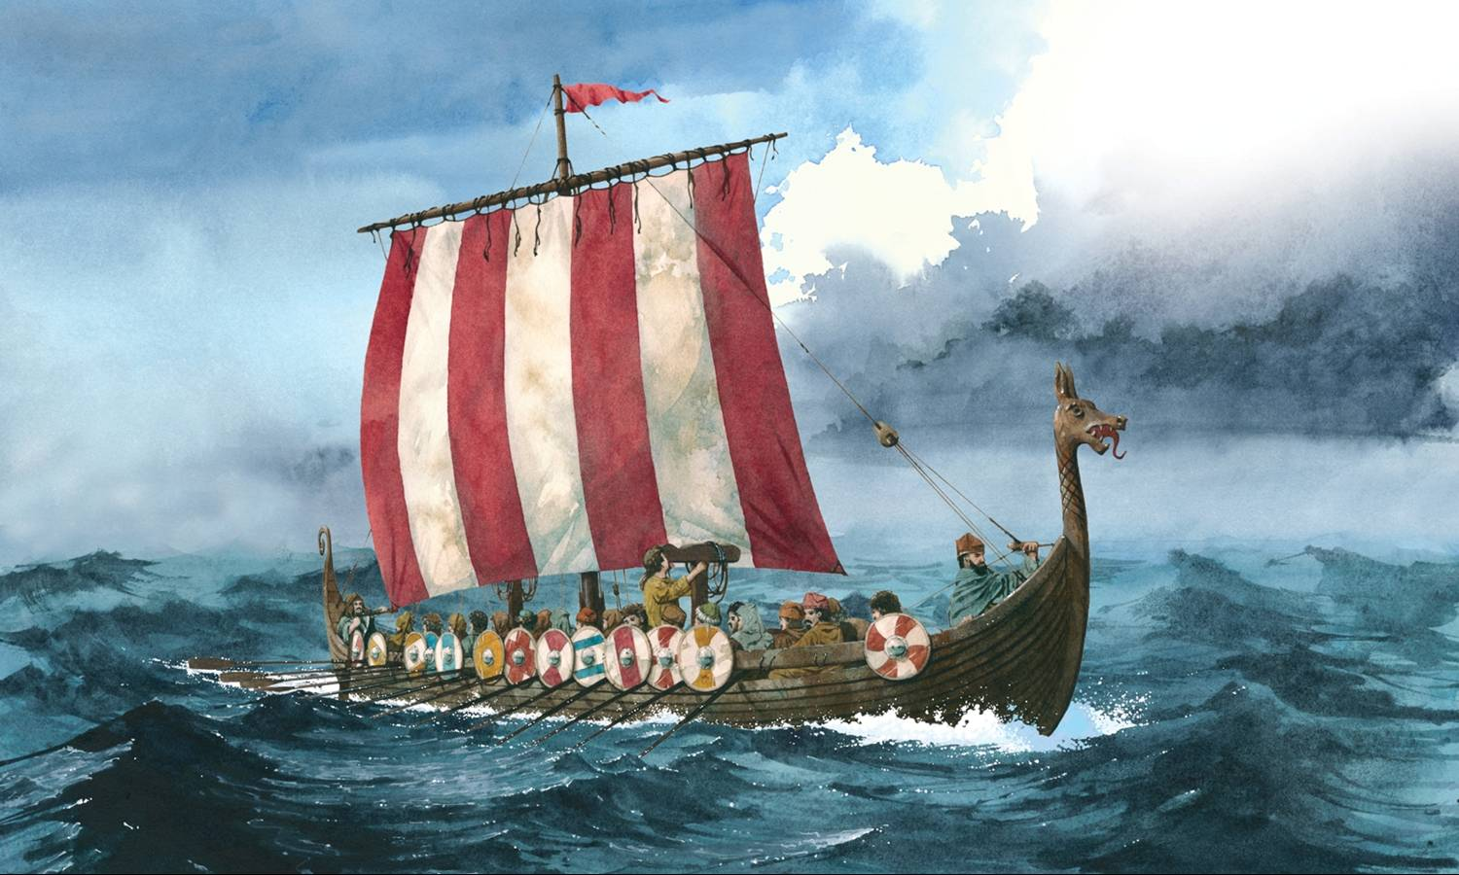
The Big Question:
Was Alfred great?
__________________ ______________________________________________________________________________________________________________________________________________________________________________________________________
The Vikings

Slide 6
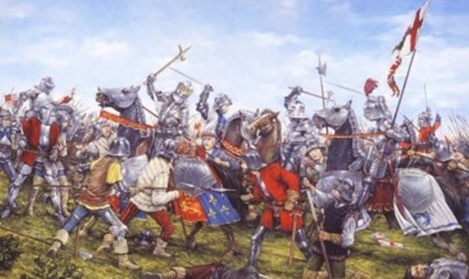
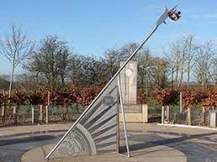
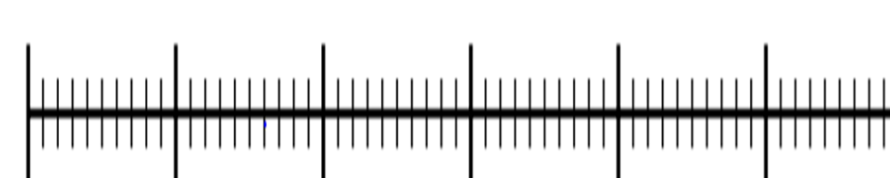
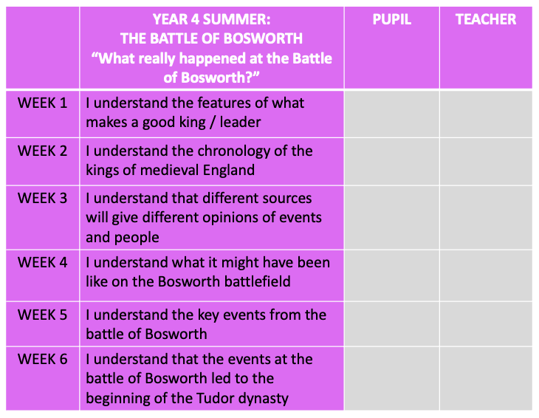
What really happened at The Battle of Bosworth?
1485
1000 AD
1100
1200
1300
1400
1500
1600
1700
1800
1900
2000 AD
Big Question:
What really happened at the Bosworth Battlefield?
______________________________________________________________________________
________________________________________________________________________________________________________________________________________________________________________________________________________________________________________________________________________________________________________________________

Slide 7
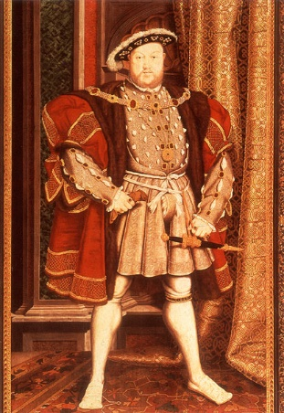
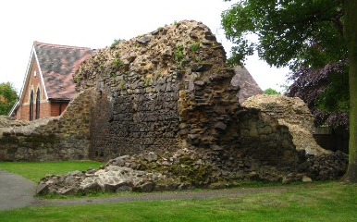
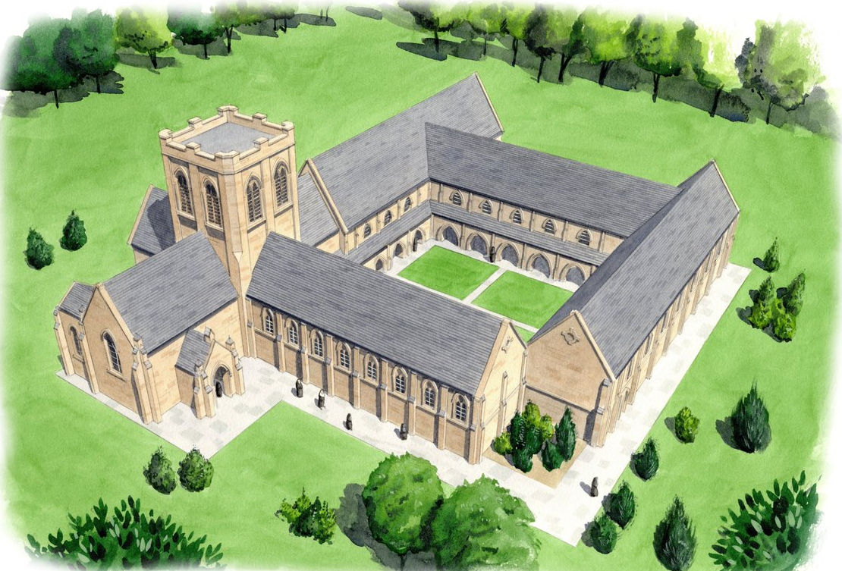
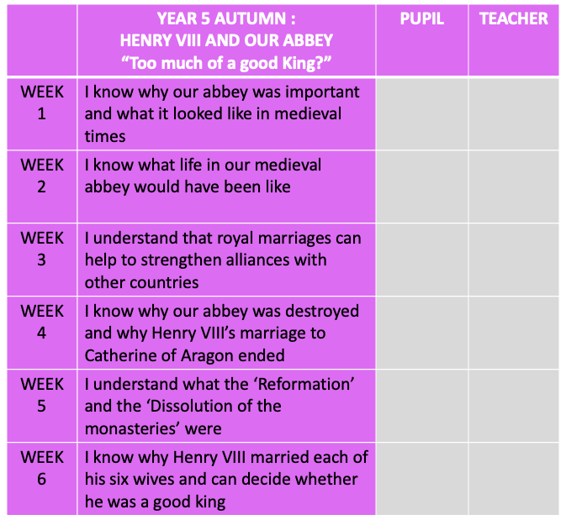
Too much of a good king?
The Big Question:
Why did Henry VIII ruin our Abbey? Can you think of 3 reasons?
Personal:_______________________________________________________________________________________________________________________________________
Religious:_______________________________________________________________________________________________________________________________________
Political:________________________________________________________________________________________________________________________________________

Slide 8
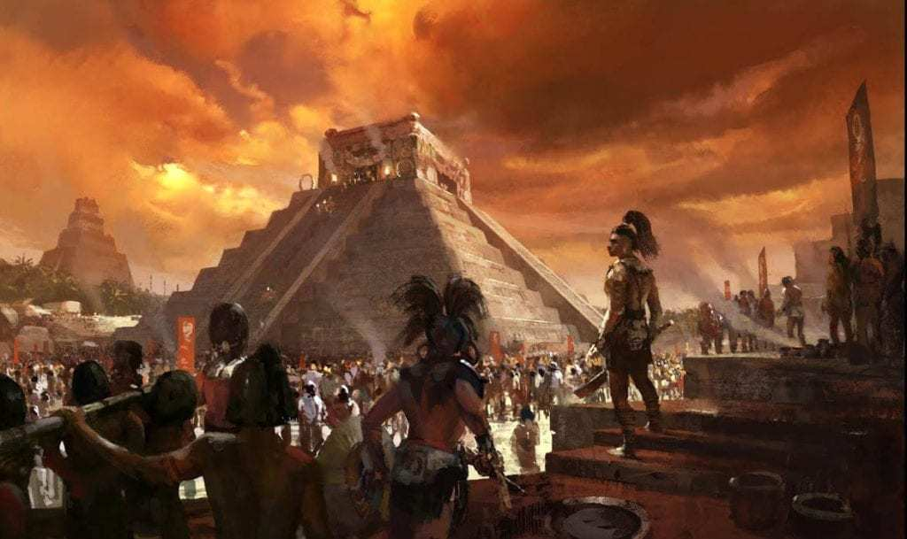
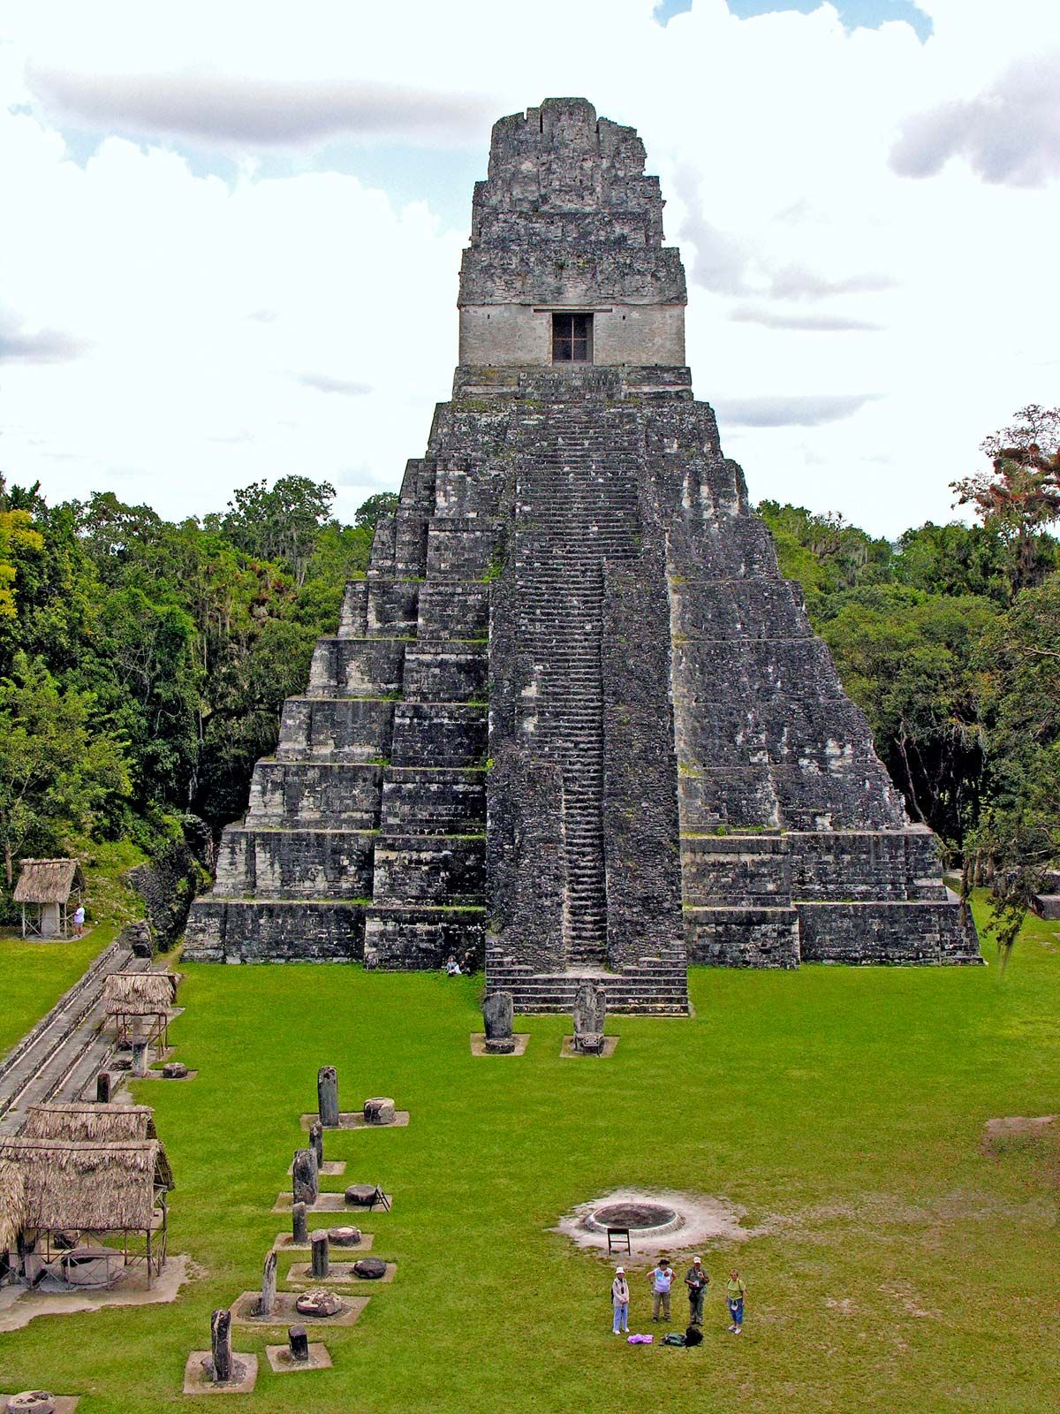
CHANGE TITLE
ADD YOUR KEY KNOWLEDGE ON WHEN DECIDE ON TOPIC TITLE AND ALL IS CONFIRMED
The Big Question: Why did the Maya build such a successful civilisation, and why did it eventually decline?
________________________________________________________________________________________________________________________________________________________________________________________________________________________________________________________________________________________________________________________________________________

Slide 9
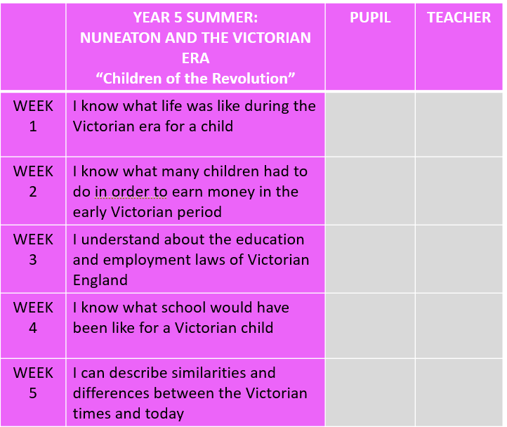
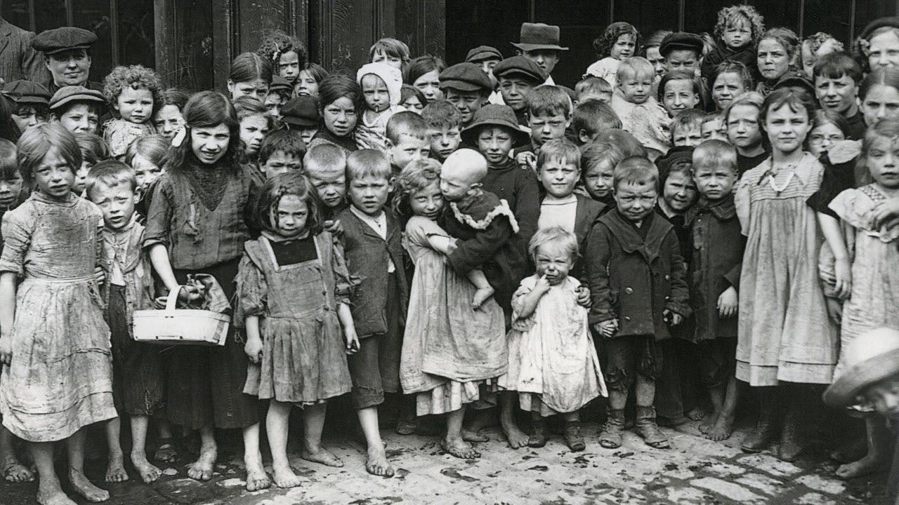
Victorian Britain:
The Big Question:
Did childhood improve in Victorian Britain? _________________________________________________________________________________________________________________________________________________________________________________________________________________________________________________________________________________________________________________________________________________________________________________

Slide 10
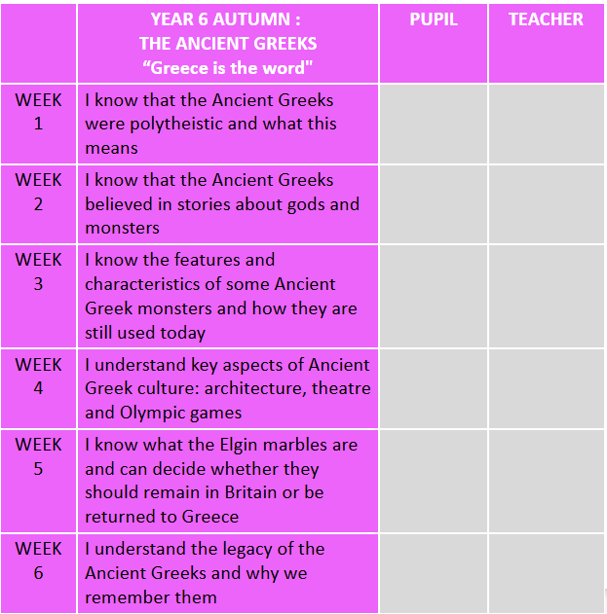
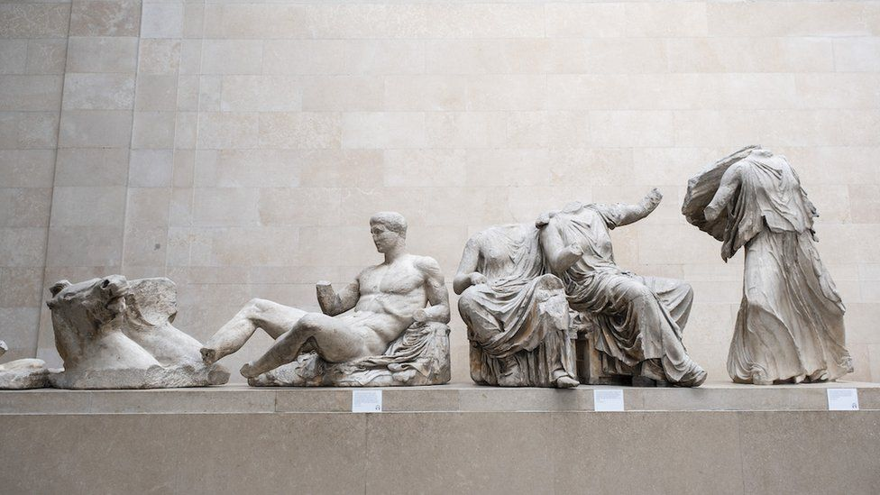
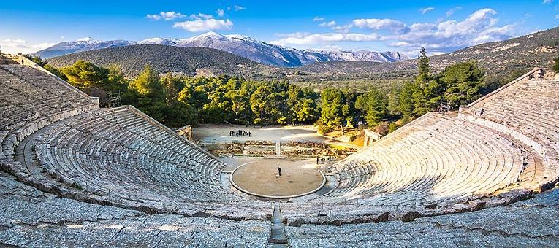
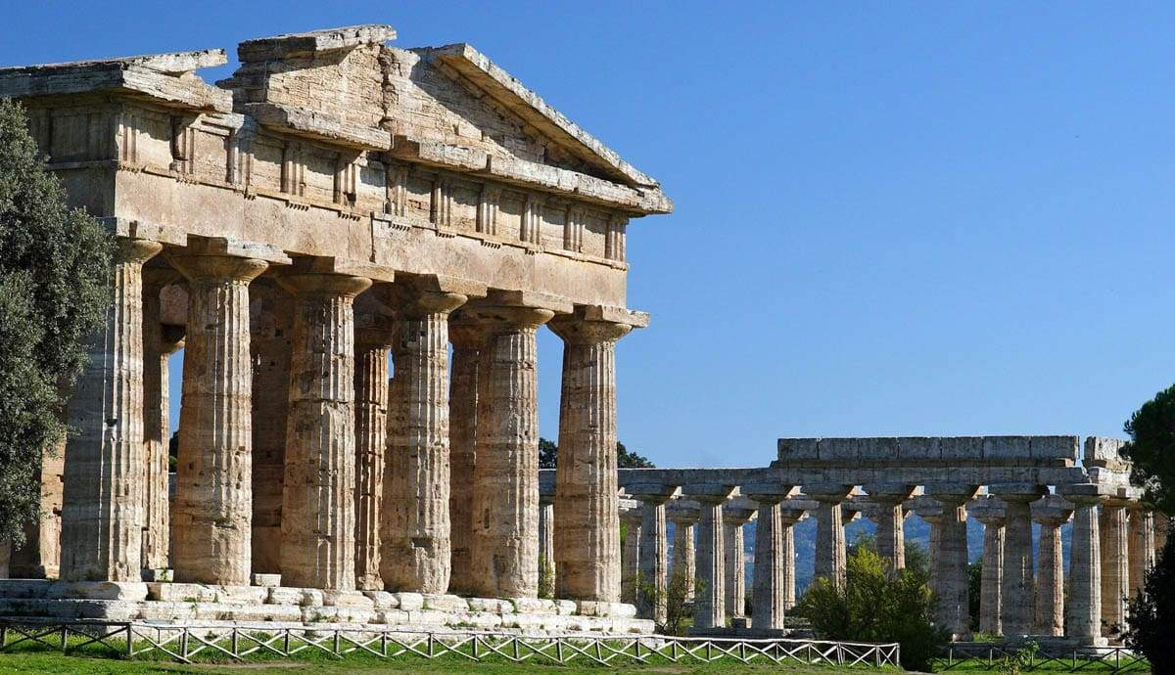

Greece is the word
The Big Question:
Why do we remember the Ancient Greeks?
________________________________________________________________________________________________
________________________________________________________________________________________________
________________________________________________________________________________________________
________________________________________________________________________________________________

Slide 11
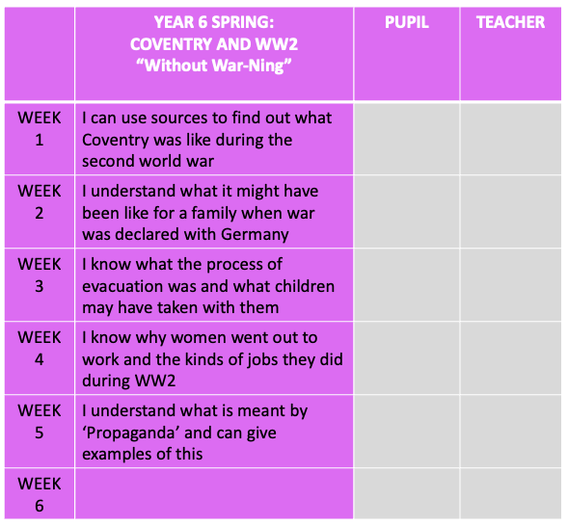
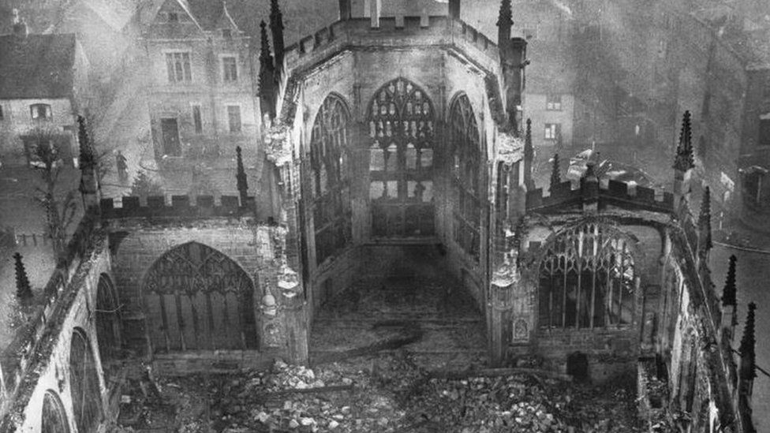
The Coventry Blitz
The Big Question: how was our locality affected by World War 2?
_____________________________________________
_____________________________________________
______________________________________________________________________________________________________________________________________________________________________________________________________________________________________________________________________________

Slide 12
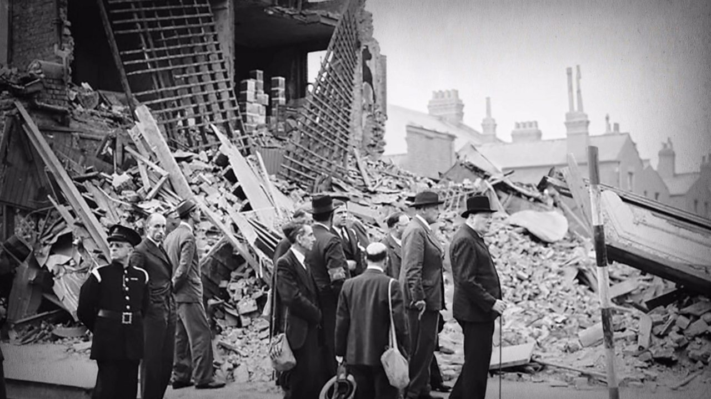

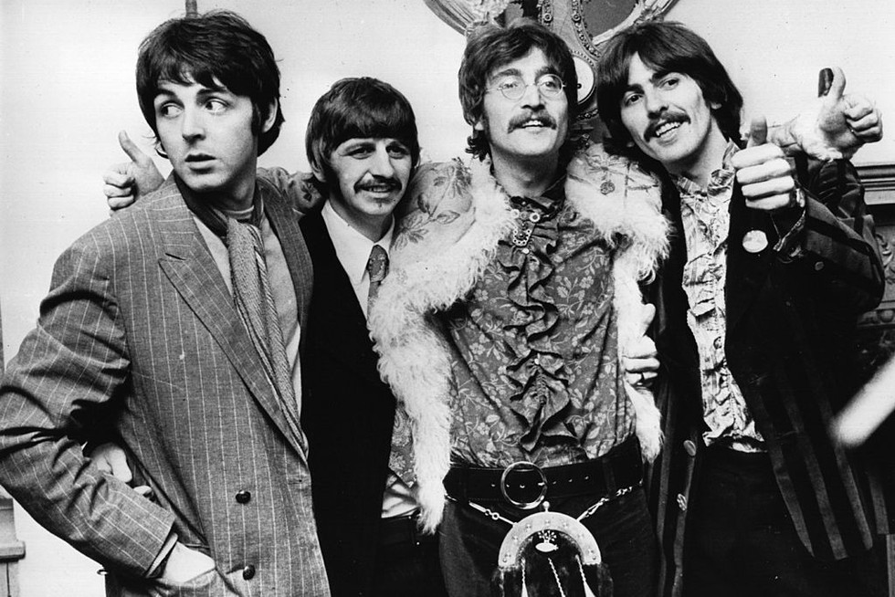
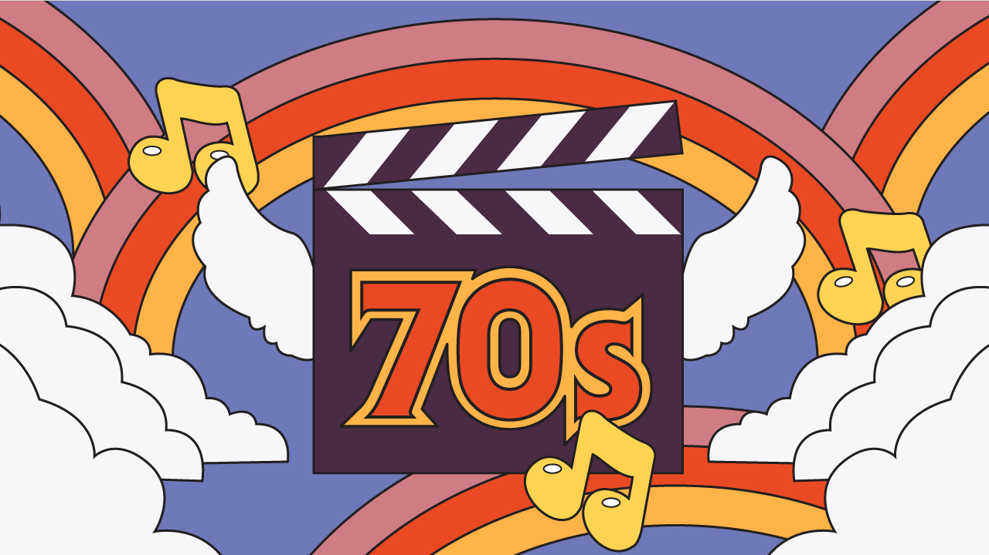

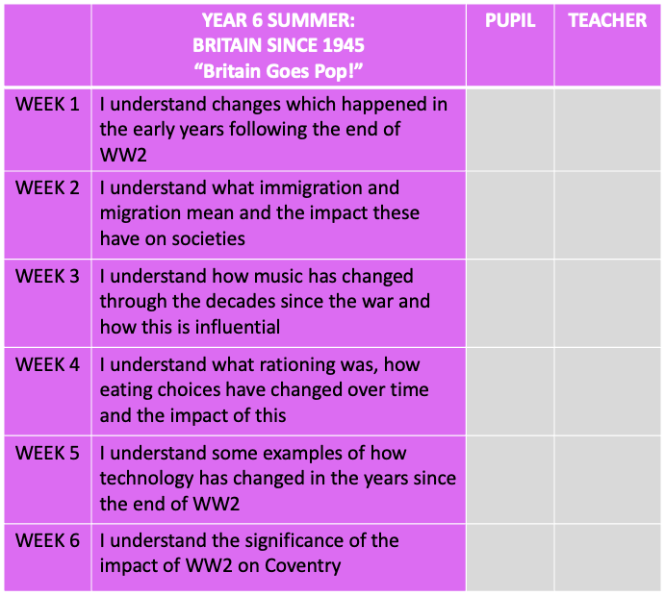
Britain Goes Pop! Britain after 1945
Big Question:
How has our society changed since the end of WW2? ___________________________________________________________________________________________________________________________________________________________________________________________________________________________________________________________________________________________________________________________________________________________________________

