Slide 1
Instructions
The first row of words are from previous topics or in the case of year 3, from Key stage 1. This should enable all children to colour some of their grid in green.
The middle row (and one or two of bottom row) are the new words for this topic
The remaining 3 or 4 words might only be picked up by GDS pupils. Ensure that anybody colouring these green proves that they can use the words by writing it in the Vocabulary in Action section.

Slide 2
Map-Makers!
Vocabulary Words I Know (beginning of topic)
North & South | United Kingdom |  | East | West |  | Poles
Tropic of Cancer | Antarctic circle |  | Continent | Arctic circle |  | Tropic of Capricorn
Prime Meridian | Hemisphere |  | Equator | Latitude |  | Longitude
I don’t know it |  | I know what it means |  |  | I can use it in a sentence
Vocabulary Words I Know (end of topic)
North & South | United Kingdom |  | East | West |  | Poles
Tropic of Cancer | Antarctic circle |  | Continent | Arctic Circle |  | Tropic of Capricorn
Prime Meridan | Hemisphere |  | Equator | Latitude |  | Longitude
I don’t know it |  | I know what it means |  |  | I can use it in a sentence
Vocabulary In Action
________________________________________________________________________________________________________________________________________________________________________________________________________________________________________________________________________________________ ________________________________________

Slide 3


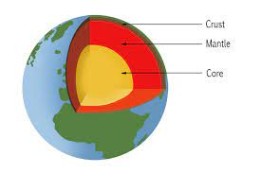

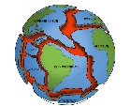


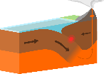
The Earth Strikes Back!
Vocabulary Words I Know (beginning of topic)
physical features | continent |  | ocean | volcano |  | earthquake
Physical processes | Crust |  | Dormant | Lava |  | Tectonic plate
Cross-section diagram | geologist |  | seismologist | Richter scale |  | subduction
I don’t know it |  | I know what it means |  |  | I can use it in a sentence
Vocabulary Words I Know (end of topic)
physical features | continent |  | ocean | volcano |  | earthquake
Physical processes | Crust |  | Dormant | Lava |  | Tectonic plate
Cross-section diagram | geologist |  | seismologist | Richter scale |  | subduction
I don’t know it |  | I know what it means |  |  | I can use it in a sentence
Vocabulary In Action
________________________________________________________________________________________________________________________________________________________________________________________________________________________________________________________________________________________ ________________________________________

Slide 4





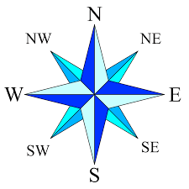
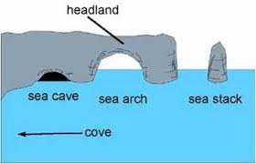





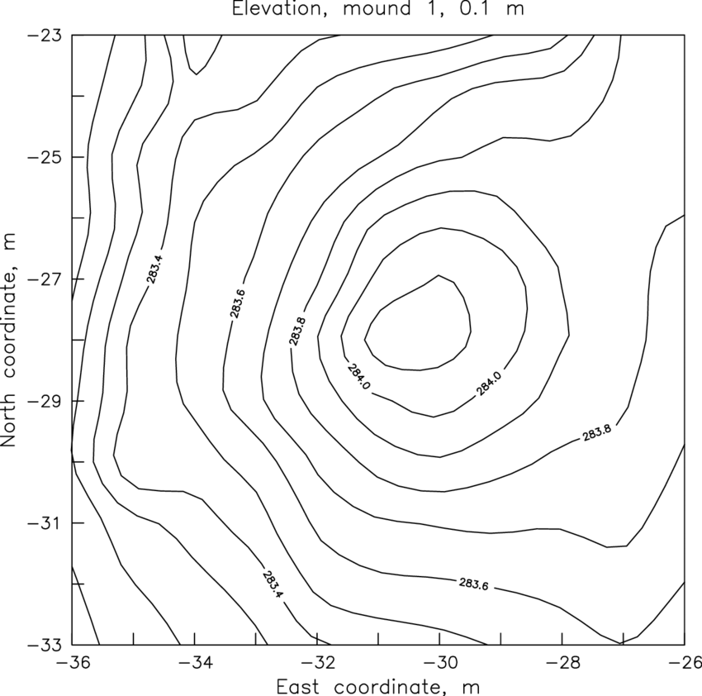
Oh, I do like to be Beside the Seaside!
Vocabulary Words I Know (beginning of topic)
Physical Processes | weathering |  | erosion | cliff |  | beach
Key | Grid reference |  | Compass points | Arch/ stack |  | headland
tourism | economic activities |  | coastal management | topography |  | Contours
I don’t know it |  | I know what it means |  |  | I can use it in a sentence
Vocabulary Words I Know (end of topic)
Physical Processes | weathering |  | erosion | cliff |  | beach
Key | Grid reference |  | Compass points | Arch/ stack |  | headland
tourism | economic activities |  | coastal management | topography |  | Contours
I don’t know it |  | I know what it means |  |  | I can use it in a sentence
Vocabulary In Action
________________________________________________________________________________________________________________________________________________________________________________________________________________________________________________________________________________________ ________________________________________

Slide 5
Biomes and Climate Zones 1
Vocabulary Words I Know (beginning of topic)
Equator | Tropic |  | Physical features | Human activity |  | Environment
Latitude | Longitude |  | vegetation ‘belts’ | climate zones (map 2) |  | Biome (map 1)
Interdependent | Representation |  | Pattern | Relationship |  | Topography (map 4)
I don’t know it |  | I know what it means |  |  | I can use it in a sentence
Vocabulary Words I Know (end of topic)
Equator | Tropic |  | Physical features | Human activity |  | Environment
Latitude | Longitude |  | vegetation ‘belts’ | climate zones |  | Biome
Interdependent | Representation |  | Pattern | Relationship |  | Topography
I don’t know it |  | I know what it means |  |  | I can use it in a sentence
Vocabulary In Action
________________________________________________________________________________________________________________________________________________________________________________________________________________________________________________________________________________________ ________________________________________

