Slide 1
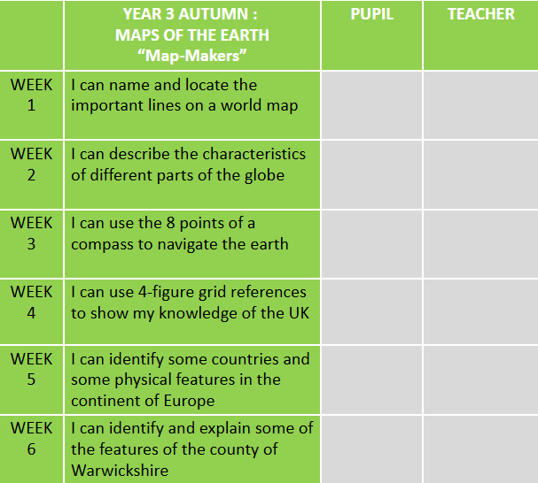
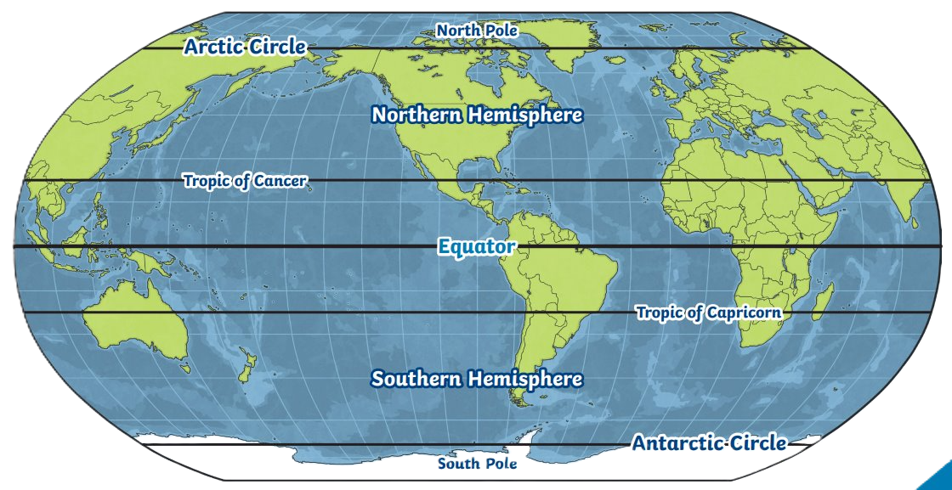
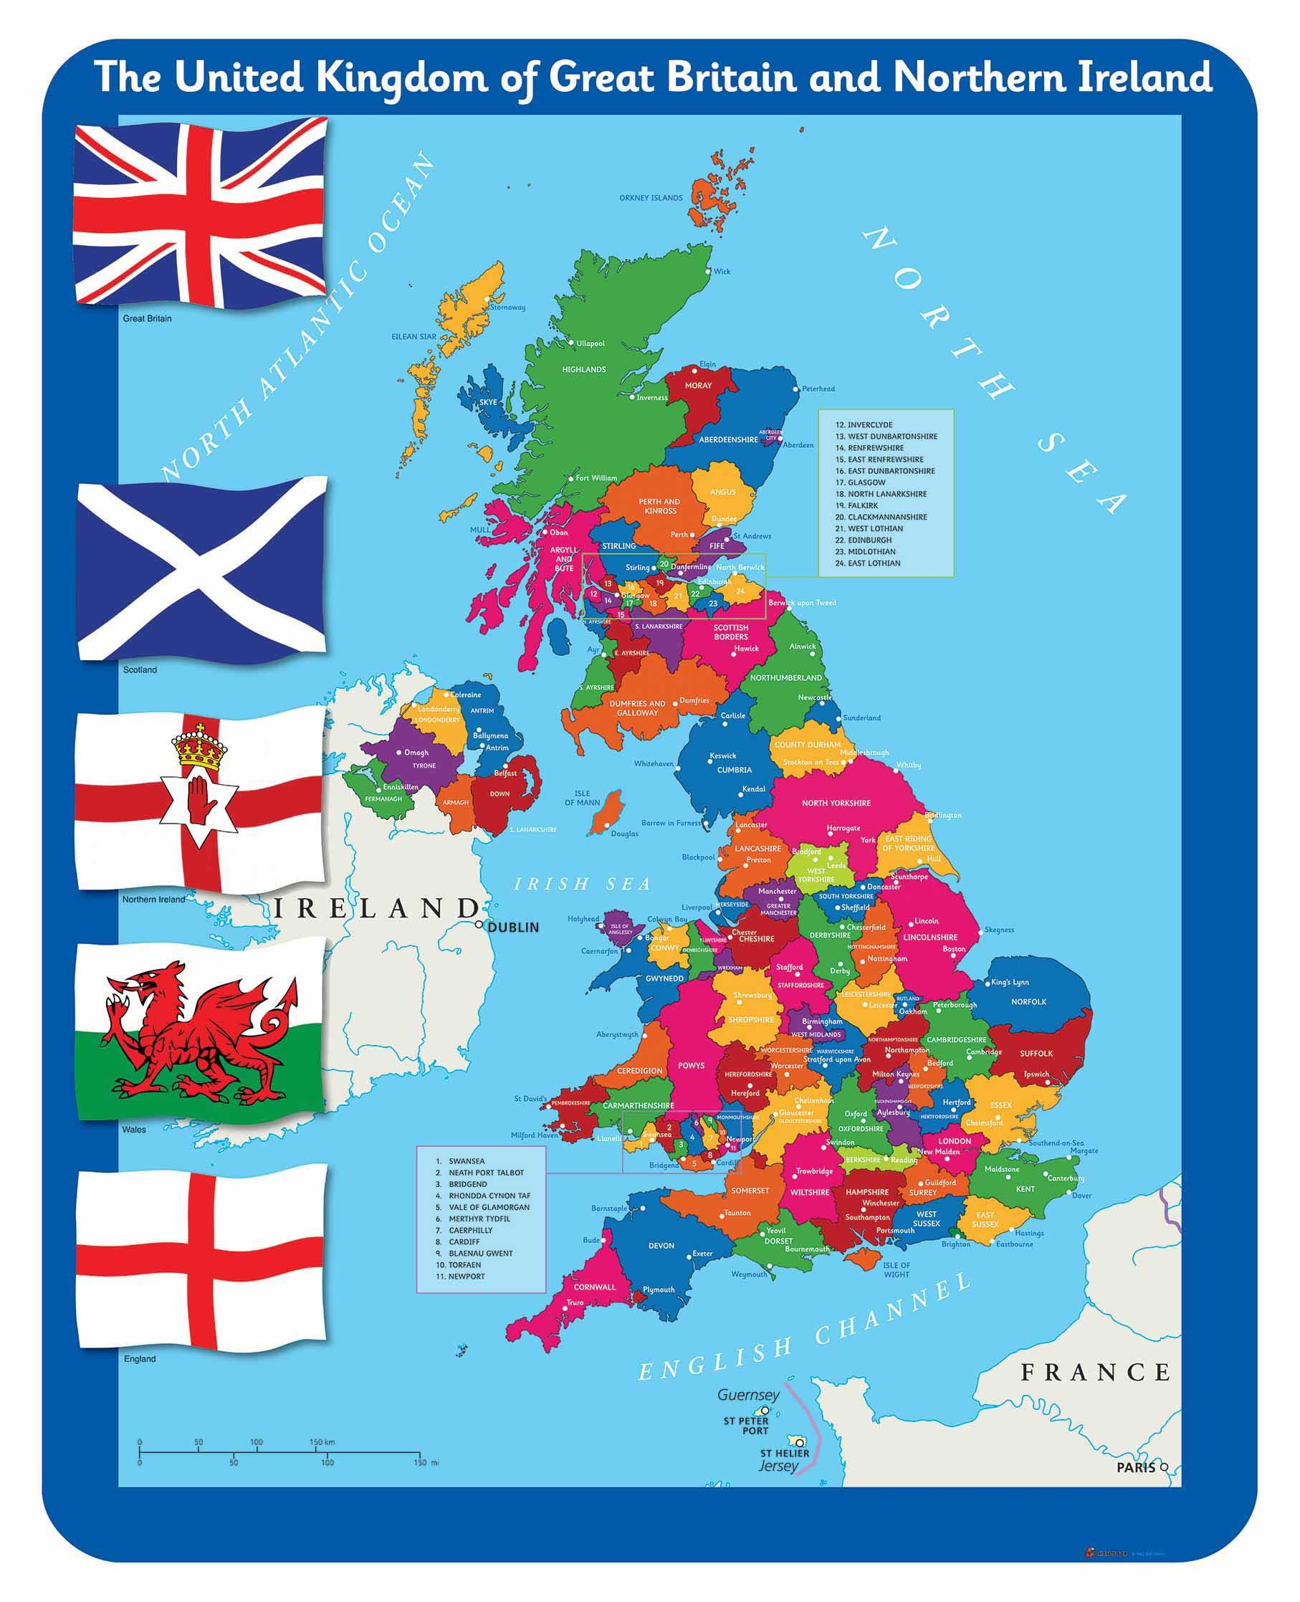
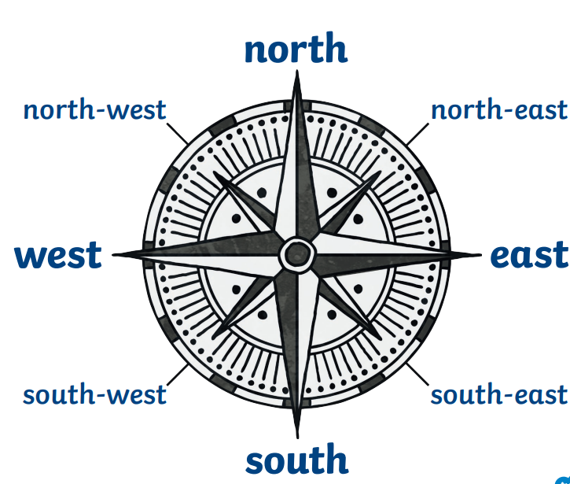
Map – Makers!
The Big Question: What makes up our world?
______________________________________________________________________________________________________________________________________________________________________________________________________

Slide 2
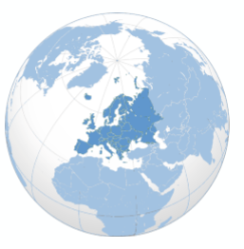
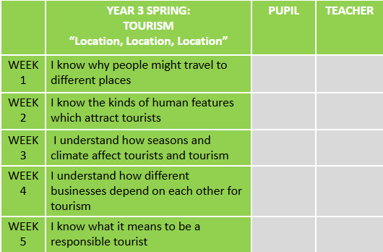
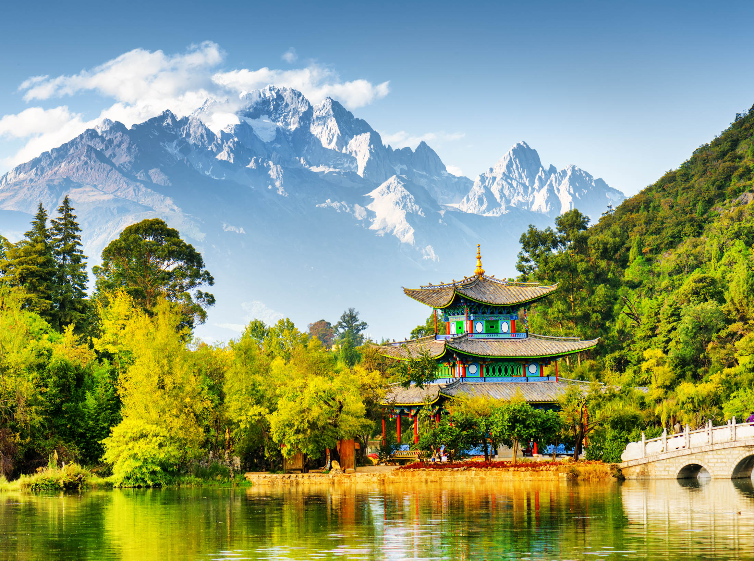
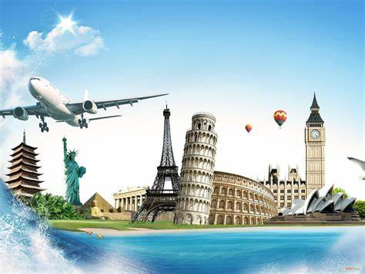
Location, Location, Location
The Big Question: What is tourism?__________________________________________________________________________________________________________________________________________________________________________________________________________________________________________

Slide 3
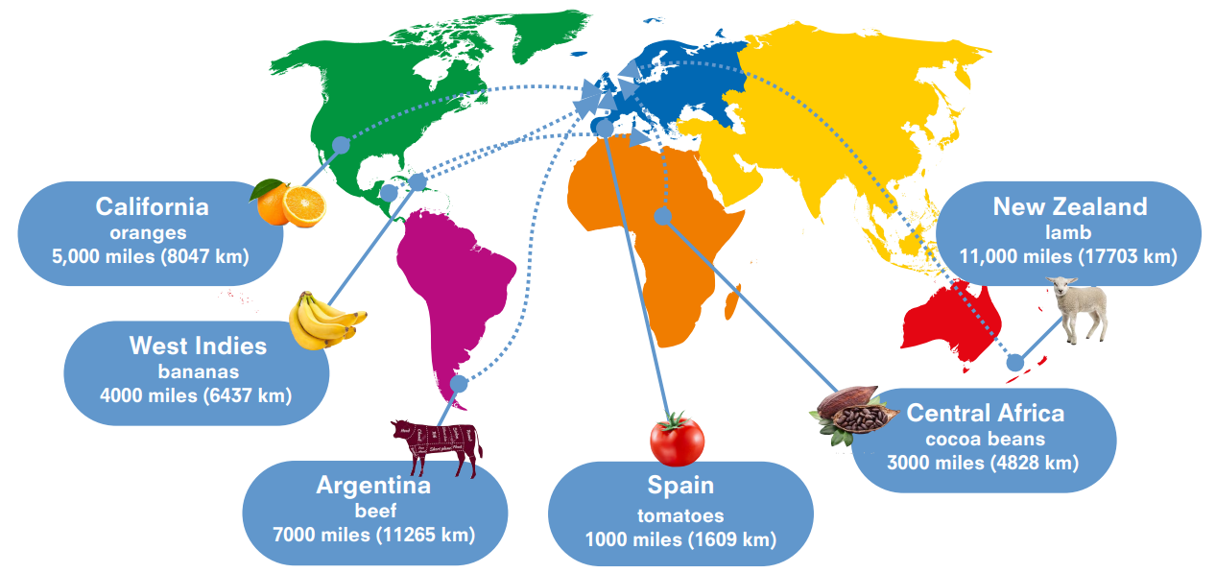
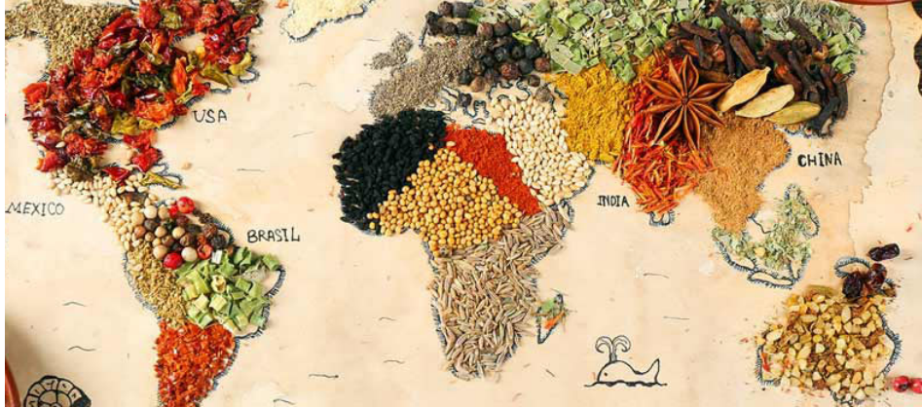
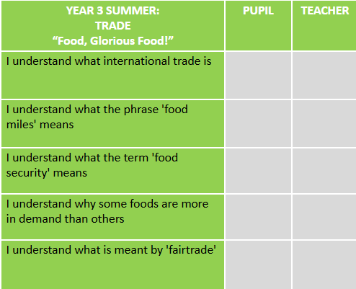
Food, Glorious, Food!
The Big Question: Where does our food come from?
____________________________________________________________________________________________________________________________________________________________________________________________________________________________________

Slide 4
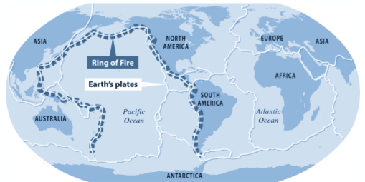
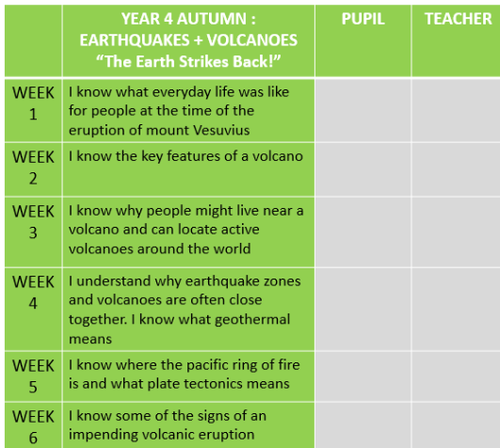
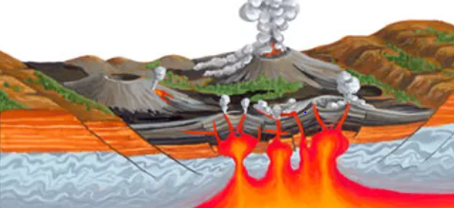
The Earth strikes back!
The Big Question: What is ‘the Ring of Fire’?
____________________________________________________________________________________________________________________________________________________________________________________________________________________________________

Slide 5
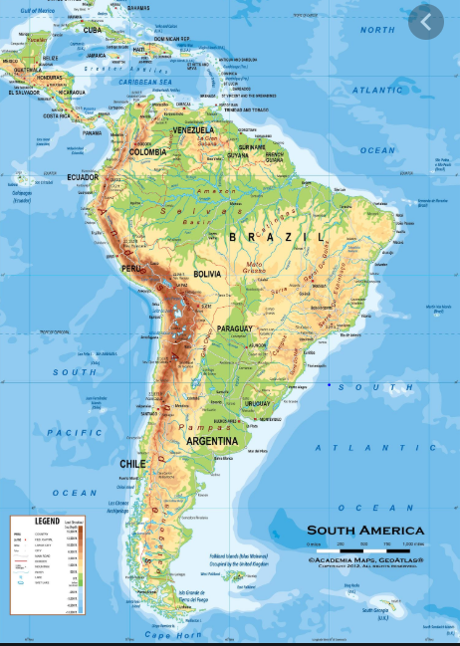
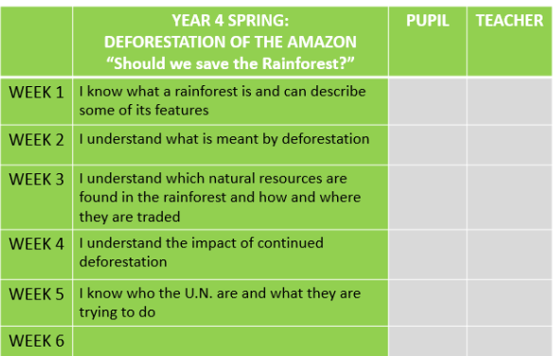
Should we save the rainforest?
The Big Question: Should we save the Amazon Rainforest?
________________________________________________________________________________________________________________________________________________________________________________________________________________________________________________

Slide 6
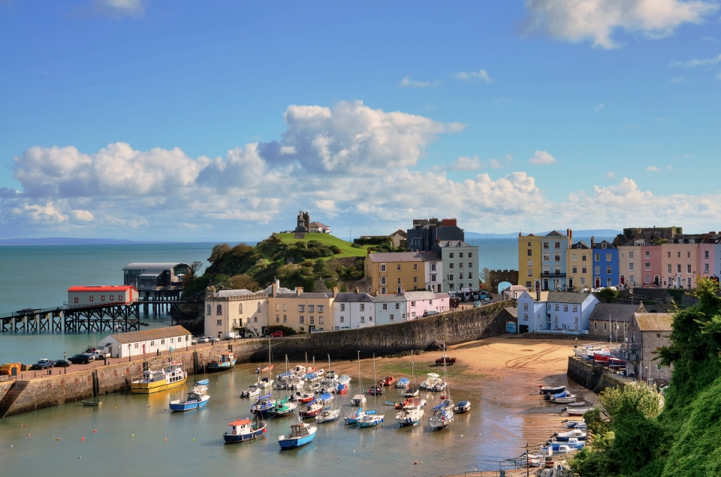
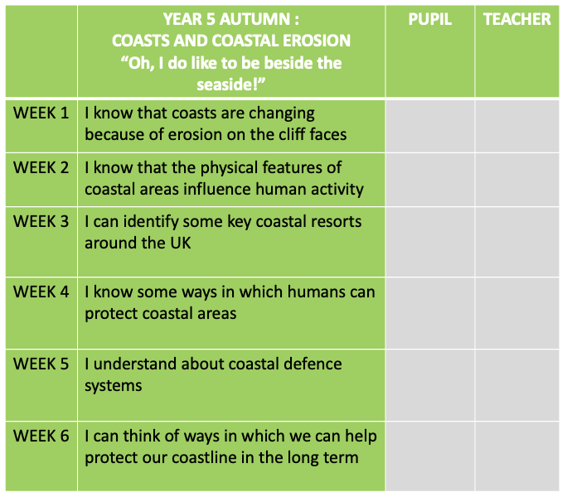
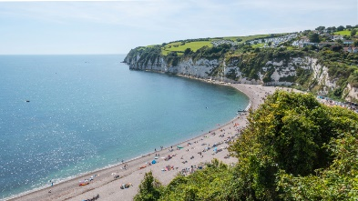
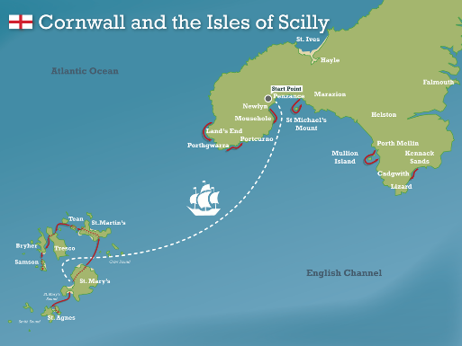
Oh, I do like to be beside the seaside!
The Big Question: How can we protect our coastline? ____________________________________________________________________________________________________________________________________________________________________________________________________________________________________________________________________________________________________________________________________________________________________________

Slide 7
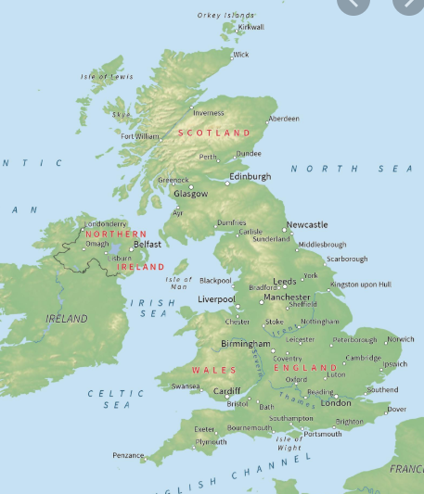
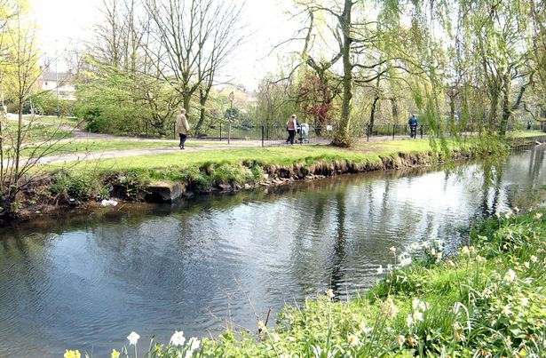
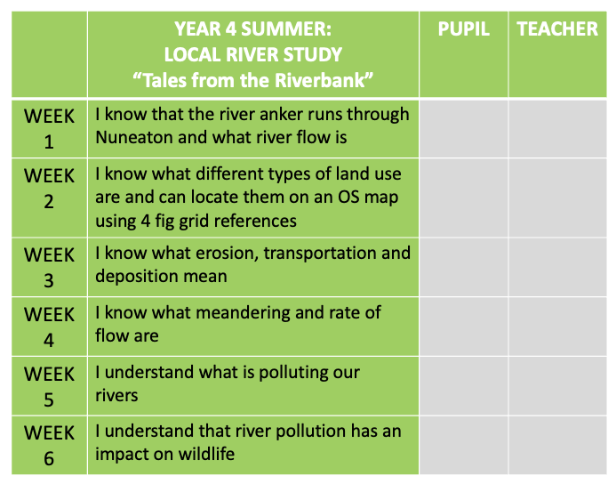
Tales of the Riverbank
The Big Question: What do rivers do?
________________________________________________________________________________________________________________________________________________________________________________________________________________________________________________________________________________________________________________________

Slide 8
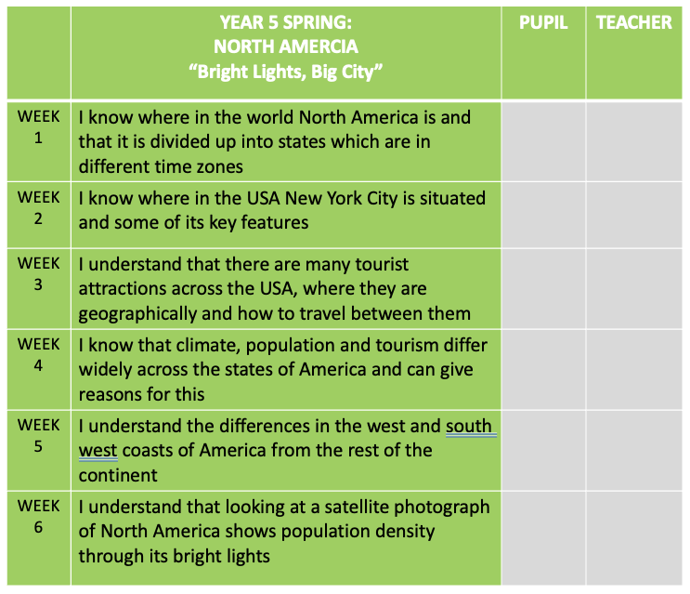
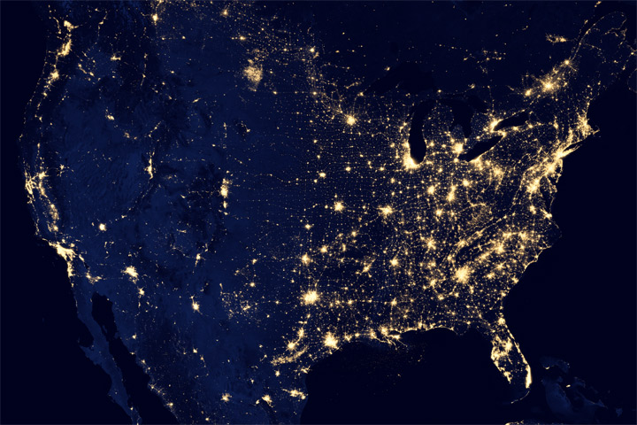
Bright Lights, Big City?
The Big Question: Where do the lights shine brightest?
______________________________________________________________________________________________________________________________________________________________________________________________________________________________________________________________________________________________________________________________________________________________________

Slide 9
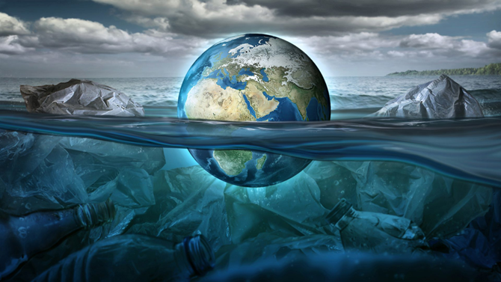
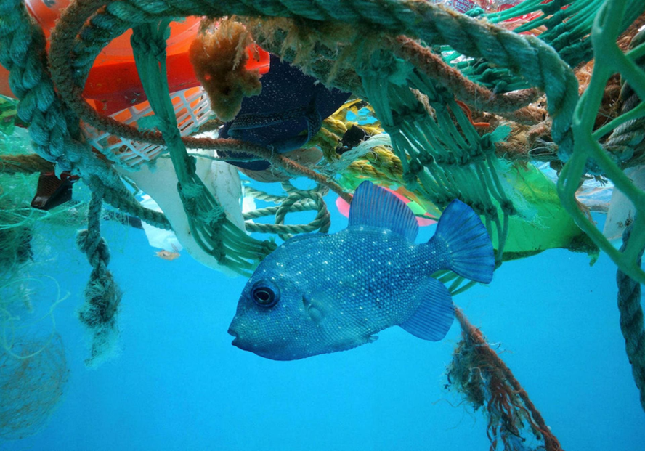
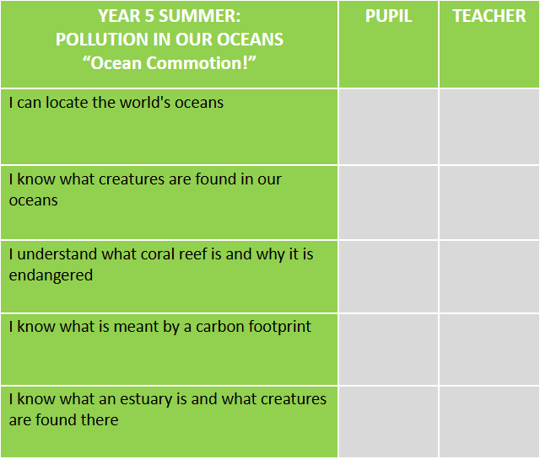
Ocean Commotion
(Pollution In Our Oceans)
Big Question:
How can we educate people about the problem of pollution in our oceans?
________________________________________________________________________________________________________________________________________________________________________________________________________________________________________________________________________________________________________

Slide 10
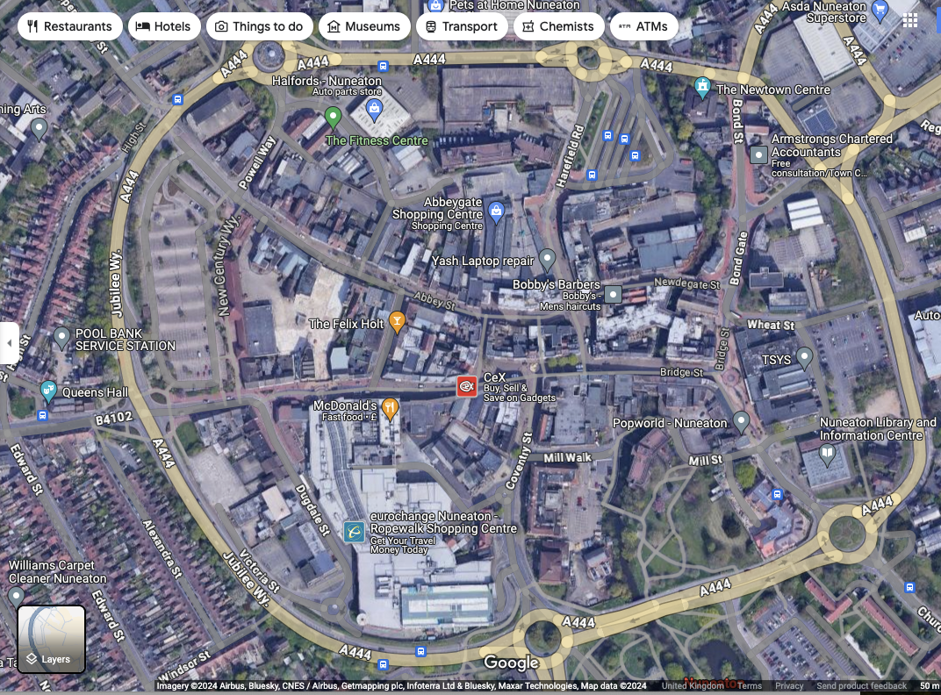

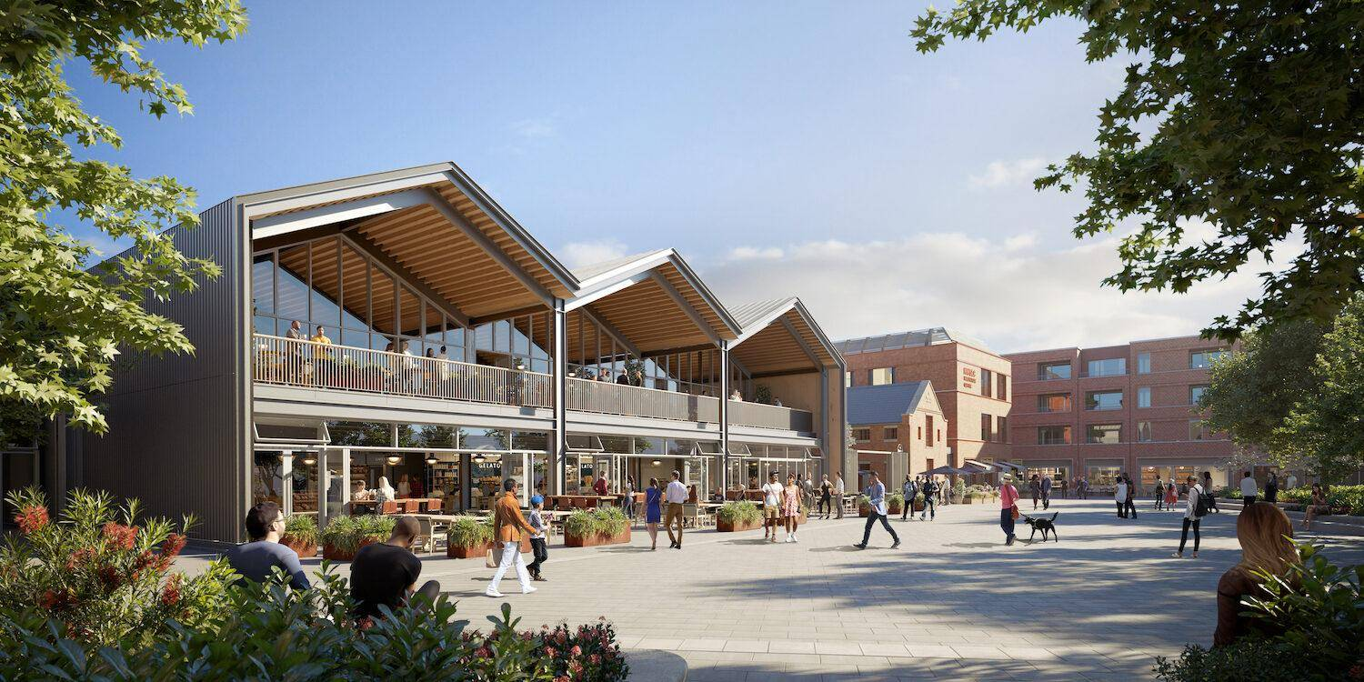
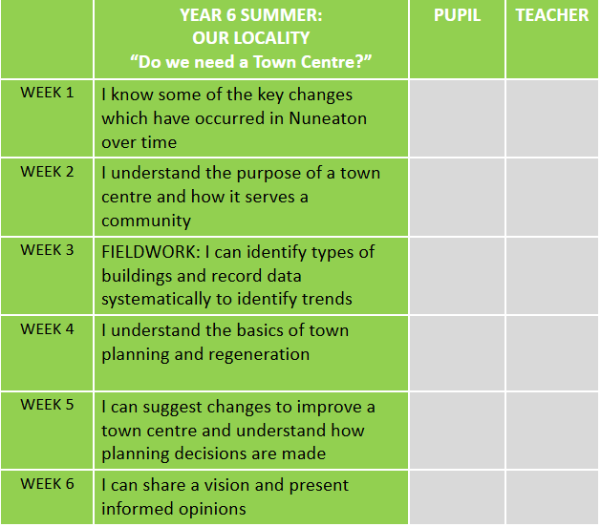
Do we need a town centre?
The Big Question: Does Nuneaton town centre have a purpose anymore?
________________________________________________________________________________________________________________________________________________________________________________________________________________________________________________________________________________________________________________________________________________________________________________

Slide 11
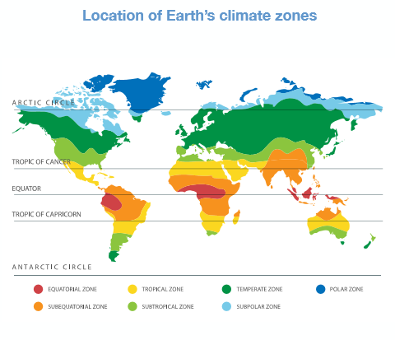
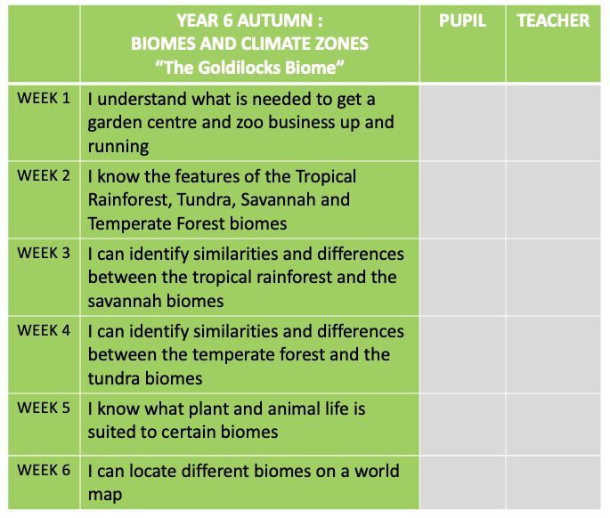
Biomes and Climate Zones 1
The Big Questions:
What patterns or relationships do we find amongst different biomes? __________________________________________________________________________________________________________________________________________________________________________________________________________________
Which other factors affect human habitation in a biome? ____________________________________________________________________________________________________________________________________________________________________________________________________________________________________________________________

Slide 12
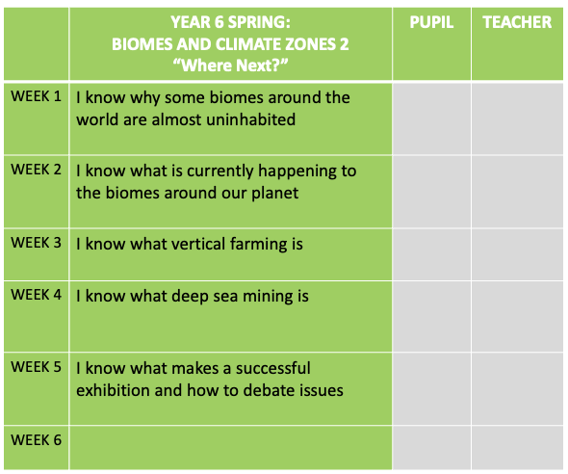
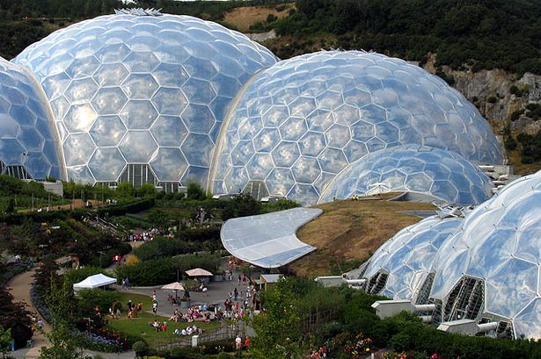
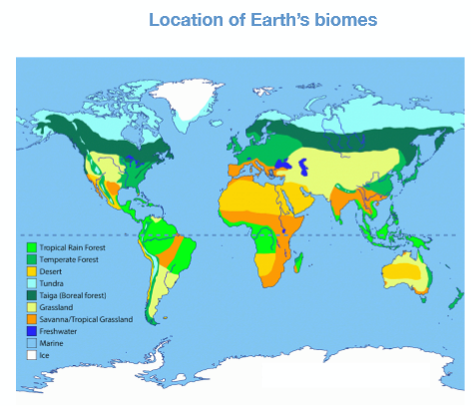
Biomes and Climate Zones 2:
The Big Question: Which biomes have the natural resources that we will need?
___________________________________________________________________________________________________________________________________________________________________________________________________________________________________________________________________________________________________________________________________________________________________________________________________________________________

